Slide 1




Substance Use, HIV, and Youth: What Clinicians Need to Know
TRAINER NAME
TRAINING DATE
TRAINING LOCATION
Notes:
TITLE SLIDE
The purpose of this introductory training is to provide HIV clinicians (including, but not limited to physicians, dentists, nurses, and other allied medical staff, therapists and social workers, and counselors, specialists, and case managers) with a detailed overview of substance abuse and HIV among youth. The curriculum reviews important epidemiological data focused on adolescent substance use trends and HIV prevalence; reviews standardized screening and assessment techniques to support the move to improve treatment effectiveness; and concludes with evidence-based and promising clinical strategies. The introductory training includes a 133-slide PowerPoint presentation, Trainer Guide, and a companion 2-page fact sheet. The duration of the training is approximately 90-120 minutes, depending on whether the trainer chooses to present all of the slides, or a selection of slides. For example, slides 43-54 represent a general introduction of HIV/AIDS, and can be eliminated if your audience already has a broad knowledge base with regards to HIV/AIDS education.
“Test Your Knowledge” questions have been inserted at the beginning and end of the presentation to assess a change in the audience’s level knowledge after the key content has been presented. An answer key is provided in the Trainer’s notes for slides 4-8 and slides 128-132.

Slide 2
Training Collaborators
Pacific AIDS Education and Training Center
  Charles R. Drew University of Medicine and Science
  University of California, Los Angeles
Pacific Southwest Addiction Technology Transfer Center
UCLA Integrated Substance Abuse Programs
2
Notes:
This PowerPoint presentation, Trainer Guide, and companion fact sheet were developed by Beth Rutkowski, M.P.H. (Associate Director of Training of UCLA ISAP) and Thomas Freese, Ph.D. (Director of Training of UCLA ISAP and Principal Investigator/Director of the Pacific Southwest ATTC) through supplemental funding provided by the Pacific AIDS Education and Training Center, based at Charles R. Drew University of Medicine and Science. We wish to acknowledge Phil Meyer, LCSW, Maya Gil-Cantu, MPH, and Tom Donohoe, MBA, from the PAETC.

Slide 3

Test Your Knowledge
Notes:
INSTRUCTIONS
The purpose of the following five questions is to test the pre-training level of substance use and HIV knowledge amongst training participants. The questions are formatted as either multiple choice or true/false questions. Read each question and the possible responses aloud, and give training participants time to jot down their response before moving on to the next question. Do not reveal the answers to the questions until the end of the training session (when you re-administer the questions that appear on slides 124-128).

Slide 4
#1: Experimentation with drugs and/or alcohol is normal during adolescence.
True
False
4
Notes:
INSTRUCTIONS
Read the question and choices, and review audience responses out loud.

Slide 5
#2: Substance use during adolescence may result in all of the following except:
  Memory problems
  Learning problems
  Intoxication (motor impairment and sedation)
  Substance Dependence
5
Notes:
INSTRUCTIONS
Read the question and choices, and review audience responses out loud.

Slide 6
#3: Who has the higher rate of current alcohol use among youth aged 12-17?
Females
Males
Rates are equal
6
Notes:
INSTRUCTIONS
Read the question and choices, and review audience responses out loud.

Slide 7
#4: Among females who are at risk for or are HIV+, all of the following variables predict substance abuse except being:
  Younger
  HIV positive
  Homeless
  Involved in the criminal justice system
  Positive for an STD
  Involved in survival sex
  Engaged in risky sex
7
Notes:
INSTRUCTIONS
Read the question and choices, and review audience responses out loud.

Slide 8
#5: Because of the relatively short duration of use, data suggests that the best intervention strategy for opioid using youth is immediate medical withdrawal followed by supportive counseling.
True
False
8
Notes:
INSTRUCTIONS
Read the question and choices, and review audience responses out loud.

Slide 9
Introductions
Briefly tell us:
What is your name?
Where do you work and what you do there?
Who is your favorite musician or performer?
What is one reason you decided to attend this training session?
9
Notes:
INSTRUCTIONS
In an effort to break the ice and encourage group interaction, take a few minutes to ask training participants to briefly share the answers to these four questions. You can ask for several volunteers to share their responses, if the size of your audience prevents all participants from sharing.
If the group is too large for formal introductions, the trainer can quickly ask participants the following two questions to gauge their work setting and professional training:
1. How many [case managers, MFTs or LCSWs, counselors, administrators, physicians, PAs, nurse practitioners, nurses, medical assistants, dentists, etc.] are in the room? Did I miss anyone? {elicit responses}
2. How many people work in a [substance abuse, mental health, primary care, infectious disease] setting? Did I miss any settings? {elicit responses}

Slide 10

“After the Party”
A video from hiv.drugabuse.gov
10
Notes:
Video Title: “Drug Abuse & HIV – After the Party” (1:00 in duration)
INSTRUCTIONS
**Allow 3-5 minutes for this activity**
Be sure to practice with the video ahead of time. If you have difficulty playing the video, refer to the instructions below or the trainer’s guide for alternate ways of accessing it.
**How to Insert the Video: This slide will contain a short video clip that will play when the trainer clicks on the static image. In order for this to work, the video needs to be inserted into the presentation. You can access the video from the http://hiv.drugabuse.gov/english/message/psas.html (hyperlink included at the top of the slide).Alternately, the video will be included in the package of training materials that is posted to the PSATTC Products and Resources page (www.psattc.org). From the INSERT menu in PowerPoint, select “video (or movie).” Select the “After the Party” video file. When prompted, indicate that the movie should play automatically and full screen. Once the video is inserted into the PowerPoint presentation, you need to maintain a direct connection between the PowerPoint presentation and the video file. When moving the PowerPoint file to another location on your computer or to another computer, make sure to always move the “After the Party” video file along with it. If the link becomes broken, the video will need to be reinserted.
To play the video, hover over the video image to make the video controls appear. Click on the play button. The video should display full screen.
Facilitate a 2-3-minute discussion with participants once the video has played regarding their impressions.

Slide 11

Educational Objectives
At the end of this training session, participants will be able to:
Define several key terms related to substance use and HIV risk among youth
Review the epidemiology of
substance use and HIV/AIDS
among youth
Discuss the intersection of substance use and HIV/AIDS among youth
Explain the key concepts of at least three effective behavioral interventions for treating substance using adolescents
11
Notes:
INSTRUCTIONS
Briefly review each of the educational objectives with the audience.

Slide 12

An Introduction to Key Terms and Definitions
12
Notes:
This section of the presentation introduces participants to several important terms and concepts that will help set the stage for a more in-depth overview of substance abuse and HIV among youth. The slides focus on a description of psychoactive substances, designer/synthetic drugs, reasons why people use psychoactive substances. If you are presenting to a SUD-savvy audience, you may decide to skip over some of the slides you feel are not essential to review.

Slide 13
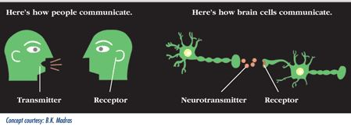

How Psychoactive Substances Work
Because of their chemical structure, alcohol and drugs have dramatic effects on neurotransmitters in CNS
Effects on:
  Mental processes
  Behavior
  Perception
  Alertness
13
SOURCE: NIDA. (2014). Drugs, Brains, and Behavior: The Science of Addiction.
Notes:
Most substance use disorders involve psychoactive substances. A psychoactive substance affects human behavior by interfering with brain chemistry and neurotransmitter activity. Alcohol and drugs that are commonly abused are psychoactive because of their chemistry. When absorbed into the body, alcohol and drugs interact with the cells and modify the way many cells, organs, and systems function. Because of their chemical structure, they have particularly dramatic effects on neurotransmitters in the Central Nervous System (CNS).
Neurotransmitters are endogenous chemicals that transmit signals from a neuron to a target cell across a synapse (the point of connection between two neurons). Neurotransmitters are packaged into synaptic vesicles clustered beneath the membrane in the axon terminal, on the presynaptic side of a synapse. They are released into and diffuse across the synaptic cleft, where they bind to specific receptors in the membrane on the postsynaptic side of the synapse. Release of neurotransmitters usually follows arrival of an action potential at the synapse, but may also follow graded electrical potentials. Low level "baseline" release also occurs without electrical stimulation. Many neurotransmitters are synthesized from plentiful and simple precursors, such as amino acids, which are readily available from the diet and which require only a small number of biosynthetic steps to convert.
Neurotransmitter image credit: Bertha K. Madras (http://www.drugabuse.gov/sites/default/files/images/soa_013.gif, Accessed October 2013).
Some drugs, such as marijuana and heroin, have chemical structures that are similar to neutral neurotransmitters, so they can lock on to and activate receptor cells. Other drugs, such as amphetamine or cocaine, cause neurons to release abnormally large amounts of neurotransmitters, or prevent their reuptake. By interfering with the way neurotransmitters function, drugs and alcohol affect many mental processes and behavior. Things like memory, attention, behavior, perception, and alertness are all changed because of what drugs and alcohol do to the neurotransmitters in the CNS.
Additional Information for the Trainer(s)
When absorbed into the body, drugs interact with and modify cells, organs, and bodily systems by:
• Altering the way the body normally functions (increasing, slowing, or enhancing bodily processes, or level or quality of functioning),
• Altering the operation of tissues, organs, and systems,
• Affecting hormones and enzymes, and
• Impacting processes such as digestion, respiration, circulation, and mental functioning.
REFERENCE
NIDA. (2014). Drugs, Brains, and Behavior: The Science of Addiction. Rockville, MD: U.S. Department of Health and Human Services, National Institutes of Health.

Slide 14
Commonly Used Psychoactive Substances
SUBSTANCE | EFFECTS
Alcohol (liquor, beer, wine) | euphoria, stimulation, relaxation, lower inhibitions, drowsiness
Cannabinoids (marijuana, hashish) | euphoria, relaxations, slowed reaction time, distorted perception
Opioids (heroin, opium, many pain meds) | euphoria, drowsiness, sedation
Stimulants (cocaine, methamphetamine) | exhilaration, energy
Club Drugs (MDMA/Ecstasy, GHB) | hallucinations, tactile sensitivity, lowered inhibition
Dissociative Drugs (Ketamine, PCP, DXM) | feel separated from body, delirium, impaired motor function
Hallucinogens (LSD, mushrooms, Mescaline) | hallucinations, altered perception
14
Notes:
The purpose of this slide is to provide an overview of the most commonly used psychoactive substances—alcohol and other drugs. Review each substance and its main effects with the audience. Tell the audience that this chart can be referenced in daily clinical practice: if they notice clients acting unusually energetic, tired, or odd, it could be because they are under the influence of one of these substances. It is important to note that these categories are not definitive. For example, ecstasy is often counted among stimulants and/or hallucinogens, and the club drugs category often includes Ketamine.
For a fun and basic lesson on how the “classic” drugs work in the brain, participants may wish to view the “Mouse Party,” available at http://learn.genetics.utah.edu/content/addiction/drugs/mouse.html.
Additional Information for the Trainer(s)
Alcohol: Many Americans drink alcohol at least occasionally. For many people, moderate drinking is probably safe. Moderate drinking is one drink a day for women or anyone over 65, and two drinks a day for men under 65. Some people should not drink at all, including children, pregnant women, people on certain medicines and people with some medical conditions. Anything more than moderate drinking can be risky. Binge drinking - drinking five or more drinks at one time - can damage health and increase risk for accidents, injuries and assault (1).
Alcohol can cause neurotransmitters to relay information too slowly, creating feelings of drowsiness. It can trigger mood and behavioral changes, including depression, agitation, memory loss, and seizures. Long-term, heavy drinking causes alterations in neurons that can affect motor coordination, temperature regulation, sleep, mood, learning, and memory. One neurotransmitter particularly susceptible to even small amounts of alcohol is glutamate, which affects memory. Researchers believe that because it interferes with glutamate, alcohol causes some people to temporarily “black out,” or forget much of what happened during a night of heavy drinking. Alcohol also causes an increased release of serotonin, another neurotransmitter, which helps regulate emotional expression (2).
Marijuana is derived from a plant containing more than 400 chemicals. Tetrahydrocannabinol (THC) is the main psychoactive ingredient in marijuana. It binds to cannabinoid (CB) receptors, which are highly concentrated in areas of the brain that control pleasure, memory, thought, concentration, sensory and time perception, appetite, pain, and movement coordination. This is why marijuana can have wide ranging effects, including: short-term memory loss, difficulty learning/retaining information, slowed reaction time, impaired motor coordination, impaired judgment and decision-making, an increased heart rate, and an altered mood. Long-term marijuana abuse can lead to dependence, poorer educational outcomes and job performance, respiratory problems, and cognitive impairment. For some people, it can also increase risk of psychosis (3).
Opioids resemble natural chemicals that have binding sites on receptors. Opioids affect parts of the brain that control emotions, and create feelings of pleasure, relaxation, and contentment. They also act on the brainstem, which controls automatic body functions, and they affect the spinal cord as well. If swallowed as pills, opioids take longer to reach the brain. If they are injected, they act faster and can produce a quick, intense feeling of pleasure followed by a sense of well-being and a calm drowsiness. While prescription pain relievers can be highly beneficial if used as prescribed, opioids as a general class of drugs have a high potential for abuse (4).
Stimulants: Cocaine is a powerfully addictive stimulant drug that can be snorted or dissolved in water and then injected. Crack is the street name given to the form of cocaine that can be smoked. The term “crack” refers to the crackling sound produced by the rock as it is heated. Injecting or smoking cocaine produces a quicker, stronger high than snorting. Cocaine works by acting on the neurotransmitter dopamine, which is associated with pleasure and movement. Normally dopamine is released by a neuron in response to a pleasurable signal (e.g., the smell of good food), and then recycled back into the cell that released it. Cocaine works by preventing dopamine from being recycled, so the pleasurable feelings caused by dopamine become amplified. With repeated use, cocaine can cause long-term changes in brain, which may eventually lead to abuse or dependence (5).
Methamphetamine is a white, odorless, bitter-tasting crystalline powder that easily dissolves in water or alcohol and is taken orally, snorted, injected, or smoked. Methamphetamine increases the release of dopamine and blocks its re-uptake. Dopamine is involved in reward, motivation, the experience of pleasure, and motor function. Methamphetamine’s ability to release dopamine rapidly creates an intense euphoria, or “rush.” Chronic use leads to structural and functional changes in areas of the brain associated with emotion and memory, causing many emotional and cognitive problems for chronic users (6).
MDMA (Ecstasy) is a synthetic, psychoactive drug that is chemically similar to the stimulant methamphetamine and the hallucinogen mescaline. The drug produces feelings of increased energy, euphoria, emotional warmth, and distortions in time, perception, and tactile experiences. MDMA is taken orally, usually as a capsule or tablet. MDMA gets its main effects by acting on neurons that use the neurotransmitter serotonin. The serotonin system plays an important role in regulating mood, aggression, sexual activity, sleep, and sensitivity to pain. MDMA binds to the serotonin transporter, thus increasing and prolonging the serotonin signal. MDMA has similar effects on another neurotransmitter—norepinephrine, which can cause increases in heart rate and blood pressure. MDMA also releases dopamine, but to a much lesser extent. The drug can produce confusion, depression, sleep problems, drug craving, and severe anxiety. MDMA can be harmful to the brain, causing long-lasting damage to neurons (7).
GHB (Xyrem) is a central nervous system (CNS) depressant. It has been approved for use in the treatment of narcolepsy. GHB acts on at least two sites in the brain: the GABA_{B} receptor and a specific GHB binding site. At high doses, GHB’s sedative effects may result in sleep, coma, or death (8). The subjective effects are described as very similar to alcohol, and the dosing range is very tight before negative effects (unconsciousness, vomiting) begin to occur.
Ketamine is a dissociative anesthetic that distorts perceptions of sight and sound, and can produce feelings of detachment. Ketamine acts on a type of glutamate receptor in the brain. Low-dose intoxication results in impaired attention, learning ability, and memory. At higher doses, ketamine can cause dreamlike states and hallucinations; and at very high doses still, ketamine can cause delirium and amnesia (8).
Hallucinogens: Compounds found in some plants and mushrooms (or their extracts) have hallucinogenic effects, causing profound distortions in perceptions of reality when consumed. Hallucinogens specifically work on certain serotonin receptor subtypes. Under the influence of hallucinogens, people see images, hear sounds, and feel sensations that seem real but are not. Some hallucinogens also produce rapid, intense emotional swings. While the exact mechanisms that make hallucinogens work are unclear, research shows that these drugs work, at least partially, by temporarily interfering with neurotransmitters and receptors. The most common hallucinogens are LSD, peyote, psilocybin, and PCP. PCP and DXM are also dissociative drugs (9).
REFERENCES
(1) National Institutes of Health. (2012). MedlinePlus: Alcohol. Available at: http://www.nlm.nih.gov/medlineplus/alcohol.html.
(2) National Institute on Alcohol Abuse and Alcoholism (NIAAA). (2010). Beyond Hangovers: Understanding Alcohol’s Impact on your Health. Rockville, MD: U.S. Department of Health and Human Services, National Institutes of Health.
(3) National Institute on Drug Abuse (NIDA). (2011). NIDA Topics in Brief: Marijuana. Rockville, MD: U.S. Department of Health and Human Services, National Institutes of Health.
(4) NIDA. (2009). Mind over Matter: Opiates. Rockville, MD: U.S. Department of Health and Human Services, National Institutes of Health.
(5) NIDA. (2010). NIDA DrugFacts: Cocaine. Rockville, MD: U.S. Department of Health and Human Services, National Institutes of Health.
(6) NIDA. (2010). NIDA DrugFacts: Methamphetamine. Rockville, MD: U.S. Department of Health and Human Services, National Institutes of Health.
(7) NIDA. (2010). NIDA DrugFacts: MDMA/Ecstasy. Rockville, MD: U.S. Department of Health and Human Services, National Institutes of Health.
(8) NIDA. (2010). NIDA DrugFacts: Club Drugs. Rockville, MD: U.S. Department of Health and Human Services, National Institutes of Health.
(9) NIDA. (2009). NIDA DrugFacts: Hallucinogens. Rockville, MD: U.S. Department of Health and Human Services, National Institutes of Health.

Slide 15
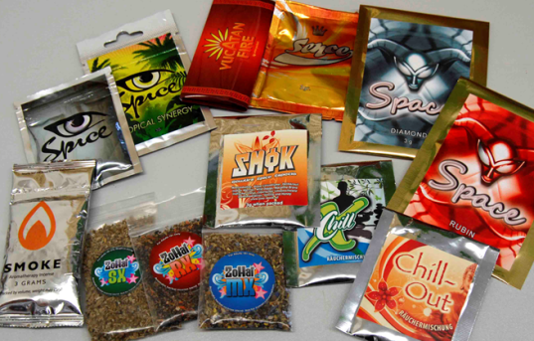

Synthetic
Drugs
Not really “Spice,” “Bath Salts,” “Incense,” or “Plant Food”
Chemically-based; not plant derived
Complex chemistry
Constantly changing to “stay legal”
Need to prove “intended to use” to convict in some areas
15
Notes:
Synthetic drugs are chemical creations that are made to cause the same changes in the user’s body as illegal drugs that are derived from plants (e.g., marijuana, cocaine). The use and abuse of synthetic drugs can produce serious health effects, including addiction, and in extreme cases, death. This slide summarizes the dilemma we are faced with because these drugs have many different “names” that are given to mask the fact they are chemical substances that have been created to produce some sort of a “high.” Although the chemical composition of some of them is known, the rogue chemists producing them are constantly changing the formulations so they can stay ahead of the latest federal and state legal definitions and laws to avoid prosecution.
Synthetic cannabinoids in herbal incense products were first detected in the United States in November 2008, by the Drug Enforcement Administration’s (DEA) forensic laboratory. These products were first encountered by U.S. Customs and Border Protection. Spice and Bath Salts are advertised as being “all natural,” safe to use, and legal but, in fact, they are none of those things. The packages often say “not for human consumption,” “for novelty use,” or “use as directed” (but without any directions for use on the package). The colorful and professional packaging and wording often changes as the laws are amended. In some jurisdictions, depending on how the laws are written, the prosecutor must prove the person intended to use the product (not just possess it), which makes it even more difficult to reduce availability of these substances.

Slide 16
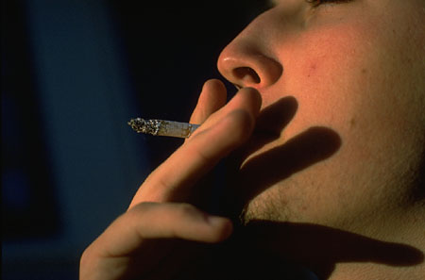




Why Do Young People Use Psychoactive Substances?
Why Start?
  Experimentation
  Peer Pressure
  Medical
Why Continue?
  Relieve stress/pain
  Function better
  Have fun/relax
  Cope with mental health disorders
16
SOURCE: NIDA. (2014). Drugs, Brains, and Behavior: The Science of Addiction.
Notes:
While there are many reasons for the initiation into and continued use of alcohol and drugs, key motivators pivot around the main factors included in the slide. People may start to experiment because of peer pressure, or for medical reasons—particularly as a way to alleviate physical pain. After initiation to alcohol/drug use, there are many reasons people continue to use these substances—they may be good ways to relieve stress or pain, or ways to help people function better in specific situations. For example, alcohol may help some people feel more at ease in social situations, while stimulant drugs like cocaine may help some people stay alert and focused while working. Also, because of their effects on neurotransmitters, these substances may help alleviate the symptoms of mental health disorders for some individuals. These motivators are not mutually exclusive. They may co-occur for many people.

Slide 17
After repeated substance use, “deciding” to use drugs is no longer voluntary because
DRUGS CHANGE THE BRAIN!
17
SOURCE: NIDA. (2014). Drugs, Brains, and Behavior: The Science of Addiction.
Notes:
Drug addiction is considered a brain disease because drugs change the structure of the brain and how it works. As a result of scientific research, we also know that addiction is a disease that affects behavior. These brain changes can be long lasting, and can lead to the harmful behaviors seen in people who abuse drugs. We have identified many of the biological and environmental factors and are beginning to search for the genetic variations that contribute to the development and progression of the disease. Scientists use this knowledge to develop effective prevention and treatment approaches that reduce the toll drug abuse takes on individuals, families, and communities. Despite these advances, many people today do not understand why individuals become addicted to drugs or how drugs change the brain to foster compulsive drug abuse.
Additional Information for the Trainer(s)
At first, people may perceive what seem to be positive effects with drug use. They also may believe that they can control their use; however, drugs can quickly take over their lives. Over time, if drug use continues, pleasurable activities become less pleasurable, and drug abuse becomes necessary for abusers to simply feel "normal." Drug abusers reach a point where they seek and take drugs, despite the tremendous problems caused for themselves and their loved ones. Some individuals may start to feel the need to take higher or more frequent doses, even in the early stages of their drug use.
The initial decision to take drugs is mostly voluntary. However, when drug abuse takes over, a person's ability to exert self-control can become seriously impaired. Brain imaging studies from drug-addicted individuals show physical changes in areas of the brain that are critical to judgment, decision making, learning and memory, and behavior control. Scientists believe that these changes alter the way the brain works, and may help explain the compulsive and destructive behaviors of addiction.

Slide 18

Why Focus on Youth?
18
Notes:
18
TRANSITION SLIDE
Many social and developmental changes take place during adolescence and into young adulthood. Social and parental control lessens during this period, and young people become freer to choose behaviors (for example, drug use or heavy drinking) and lifestyles that are not constrained by others. Because some emerging adults will maintain or increase their problematic drug or alcohol use over time (rather than mature out of such use and related problems), it is important to intervene effectively before they develop long-lasting drug use patterns or disorders.
18

Slide 19
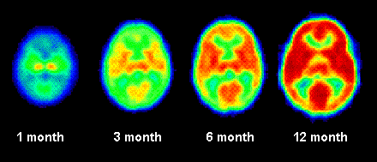
The Brain Undergoes Tremendous
Changes During Development
Increase of brain activity that accompanies
the growth of the brain, in the same patient,
from the age of 1 to 12 months.
19
SOURCE: NIDA. (2014). Drugs, Brains, and Behavior: The Science of Addiction.
Notes:
It is common knowledge that the brain undergoes tremendous changes early in development. This slide shows increases in activity across the brain during the first year after birth. The more red exhibited, the more activity is seen in that area.
19

Slide 20
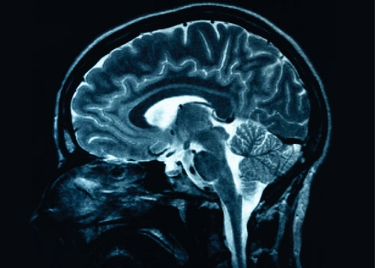
Continuing Brain Development during Adolescence
Strengthening the Circuitry
  Synaptic connections are strengthened
Pruning Unused Connections
  Adolescent brain is in a unique state of flux
  Neurons are eliminated, pruned and shaped
  This process is influenced by interactions with the outside world (Gogtay et al., 2004)
  Pruning occurs from back to front so frontal lobes mature last.
Other brain areas are also growing during adolescence (e.g., sub-cortical areas, receptors)
20
Notes:
Substantial changes continue throughout adolescence and into young adulthood. Early in childhood, the brain produces an extremely large number of connections across the brain, many more than will be needed later in adulthood. During adolescence and young adulthood, the brain strengthens important connections. At the same time, it eliminates and shapes connections to increase efficiency. The pruning of neurons occurs from the back of the brain to the front of the brain, so that frontal lobes are the last to fully form.
REFERENCE
Gogtay, N., et. al. (2004). Dynamic mapping of human cortical development during childhood through early adulthood. Proceedings of the National Academy of Sciences, 101, 8174-8179.
20

Slide 21
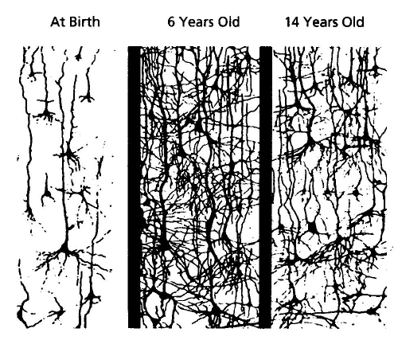
Continuing Brain Development
Early in development, synapses are rapidly created and then pruned back. Children’s brains have twice as many synapses as the brains of adults. SOURCE: Shore, 1997.
21
Notes:
**ANIMATION**
This drawing illustrates the pruning process.
Move forward to reveal first picture
Between birth and 6 years of age…
Move forward to reveal second picture
…there is a tremendous proliferation of neural connections.
Move forward to reveal final picture
This is followed by sustained thinning starting around puberty. Scientists think this process reflects greater organization of the brain as it prunes redundant connections, and increases in myelin, which enhance transmission of brain messages.
REFERENCE
Shore, R. (1997). Rethinking the Brain. New York: Families and Work Institute.
21

Slide 22
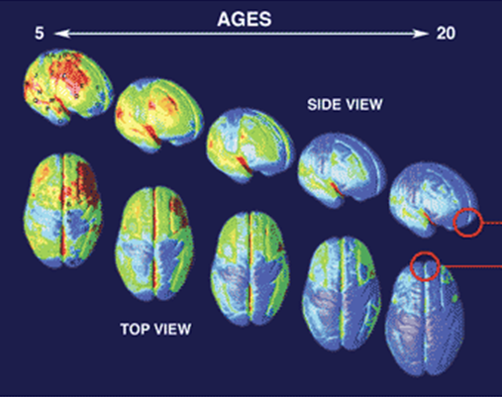
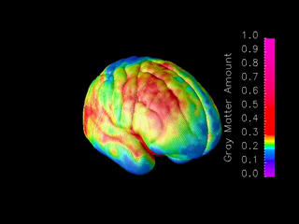
Brain Development
Ages 5-20 years
MRI scans of healthy children and teens compressing
15 years of brain development (ages 5–20).
Red indicates more gray matter, blue less gray matter.
Neural connections are pruned back-to-front.
The prefrontal cortex ("executive" functions), is last to mature.
Information taken from NIDA’s Science of Addiction
http://www.drugabuse.gov/ScienceofAddiction/
SOURCE: Gagtay, et al., 2004.
22
Notes:
22
Constructed from MRI scans of healthy children and teens, the time-lapse movie, from which the above images were extracted, compresses 15 years of brain development (ages 5–20) into just a few seconds. Red indicates more gray matter, blue less gray matter. Gray matter wanes in a back-to-front wave as the brain matures and neural connections are pruned. Areas performing more basic functions mature earlier; areas for higher order functions mature later. The prefrontal cortex, which handles reasoning and other "executive" functions, emerged late in evolution and is among the last to mature. Studies in twins are showing that development of such late-maturing areas is less influenced by heredity than areas that mature earlier.
**ANIMATION**
This slide has complex animations and the trainer should practice prior to training. A step-by-step guide is provided below.
The first bullet comes in automatically at the beginning of the slide. Provide the following description:
This slide demonstrates the neural pruning through animations. This is a series of MRI scans from healthy children showing brain development as they age from 5 to 20 years.
Move forward to reveal the next bullet, and present the information:
Red indicates more gray matter and blue indicates less gray matter.
Move forward and a small brain image will briefly appear on the lower right and then a short movie will automatically play full screen showing brain maturation. Once it stops, the small image of the brain will appear again on the lower right of the slide. Move forward to reveal the next bullet:
As you can see, the pruning occurs from the back of the brain toward the front.
Move forward to reveal the last bullet:
This means that the prefrontal cortex (responsible for executive functioning, like decision-making) is the last to mature.
Point out that the animation is replaying so that people can see it again. A static image of the progression will appear on the lower left as well. When people have had time to observe, move forward to next slide.
**How to Insert the Video: This slide will contain a short video clip that will play after the trainer clicks ahead to the third bullet. In order for this to work, the video needs to be inserted into the presentation. You can access the video from the package of training materials that is posted to the PSATTC Products and Resources page (www.psattc.org). From the INSERT menu in PowerPoint, select “video (or movie).” Select the “PR Brain Maturing” video file. When prompted, indicate that the movie should play automatically and full screen. Once the video is inserted into the PowerPoint presentation, you need to maintain a direct connection between the PowerPoint presentation and the video file. When moving the PowerPoint file to another location on your computer or to another computer, make sure to always move the “PR Brain Maturing” video file along with it. If the link becomes broken, the video will need to be reinserted.
To play the video, hover over the video image to make the video controls appear. Click on the play button. The video should display full screen.
REFERENCES
NIDA. (2007). Drugs Brains, and Behavior: The Science of Addiction (NIH Pub No. 07-5605). Downloaded from http://www.drugabuse.gov/ScienceofAddiction.
Gogtay, N., et. al. (2004). Dynamic mapping of human cortical development during childhood through early adulthood. Proceedings of the National Academy of Sciences, 101, 8174-8179.
22

Slide 23
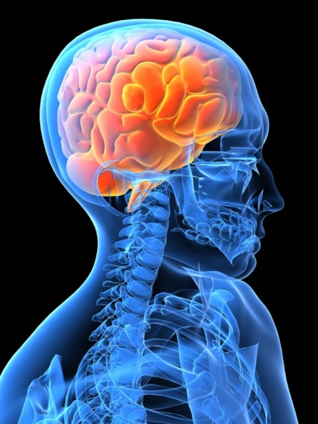

The Interaction between the Developing Nervous System and Substances of Abuse Leads to:
Difficulty in decision making
Difficulty understanding the
consequences of behavior
Increased vulnerability to
memory and attention problems
This can lead to:
Increased experimentation
Alcohol and drug addiction
23
SOURCE: Fiellin, 2008.
Notes:
In reality, the exact impact of substance use on the developing brain is not known. However, when we look at the impact on the adult brain and understand normal development, several things seems true about this interaction, including that it may lead to difficulties in decision making and understanding the consequences of behavior (Fiellin, 2008). Additionally, it may increase the risk of memory and attention problems. These impairments, in turn, may lead to increased experimentation across a variety of behaviors; and increase the risk of addiction to a variety of substances (Fiellin, 2008).
REFERENCE
Fiellin, D.A. (2008). Treatment of adolescent opioid dependence: No quick fix. Journal of the American Medical Association, 300(17), 2057-2059.
23

Slide 24
Young Brains are Different from Older Brains
Alcohol and drugs affect the brains of adolescents and young adults differently than they do adult brains
  Adolescent rats are more sensitive to the memory and learning problems than adults
  Conversely, they are less susceptible to intoxication (motor impairment and sedation) from alcohol
These factors may lead to higher rates of dependence in these groups
24
SOURCE: Hiller-Sturmhöfel & Swartzwelder, 2004/2005.
Notes:
24
The brain continues to develop into adulthood and undergoes dramatic changes during adolescence. This means that young brains are different from older brains. One example of this difference is evidenced by the fact that adolescent rats are: more susceptible to the effects of alcohol on memory and learning, but less susceptible to the motor and sedative effects.
These factors may combine to increase the vulnerability to substance dependence in adolescents and young adults.
REFERENCE
Hiller-Sturmhofel, S., & Swartzwelder, H.S. (2004/2005). Alcohol’s effects on the adolescent brain: What can be learned from animal models. Alcohol Research & Health, 28(4), 213-221.
24

Slide 25
Substance Use Disorder Onset
NSDUH Age Groups
100
Severity Category
90
Adolescent Onset
Remission
80
No Alcohol or Drug Use
70
Light Alcohol Use Only
60
Any Infrequent Drug Use
50
40
Regular AOD Use
30
Abuse
20
10
Dependence
0
12-13
14-15
16-17
18-20
21-29
30-34
35-49
50-64
65+
25
Source: Chan et al., 2008.
Notes:
This figure shows how substance use disorders typically begin during adolescence and young adult hood (in other words, of those individuals who went on to develop a substance use disorder, what age were they at onset of substance use). The red arrow indicates a rapid increase (onset) in younger years (under age 20); the blue arrow indicates a gradual decline (remission) during adult years. In fact, 90% of all adults with diagnosable dependence started using alcohol and/or drugs under the age of 18; half (50%) started using under the age of 15. Screening, assessment, and evaluation (through data collection and monitoring, at minimum) is a key way to inform clinicians how to intervene and address substance-related problem as early as possible. If an individual reaches adulthood without developing substance dependence, he/she is less likely to develop substance dependence in adulthood.
REFERENCE
Chan, Y.F., Dennis, M.L., & Funk, R.R. (2008). Prevalence and comorbidity of major internalizing and externalizing problems among adolescents and adults presenting to substance abuse treatment. Journal of Substance Abuse Treatment, 34(1), 14-24.

Slide 26

Where have we been?
Past decade, adolescent substance use field has gained growing attention
  Moving away from adult paradigm
Since 1997, research has grown tremendously
  Supporting the field as an “emerging science” (still in development)
26
Notes:
Applying adult treatment models to adolescents is not an effective way to adapt services that are age appropriate. A great need exists to develop intervention strategies that are age-specific and address the developmental processes that occur during adolescence. Over the past decade, the substance use disorder treatment field has garnered a lot of attention, and research has grown significantly, but there is a lot more work to be done.

Slide 27
An Expansion of Adolescent Substance Use Disorder Research
Feature | 1930-1997 | 1997-2013
Treatment Studies | 16 | 500+
Random/Quasi | 9 | 48+
Tx Manuals | 0 | 50+
QA/Adherence | Rare | Common Practice
Epidemiology Studies | Slow | Common Tracking
Evaluations | Descriptive/Simple | More Advanced
Economic | Some Cost | Cost, CEA, BCA
Growth has helped shape service improvement efforts
27
Notes:
We have seen an explosion since the late 1990s in various adolescent substance use disorder research areas, such as epidemiology, clinical/intervention model development, and
outcomes/evaluation. This has helped to shape treatment prevention and service improvement agendas. This table highlights the recent growth, as evidenced by the far right
column (1997-2013), as compared to historical data (1930-1997).

Slide 28

The Epidemiology
of Adolescent Substance Use
28
Notes:
Adolescents and young adults have increased vulnerability to, and the potential for increased problems from substance use. The next series of slides will look specifically at prevalence of alcohol and drugs in this population.

Slide 29

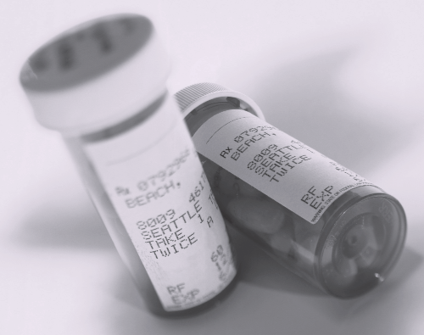
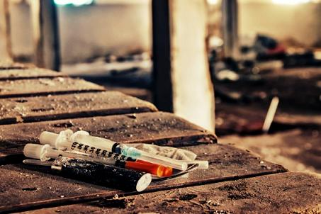
Every Generation of Teens Looks for New Ways to Get “High”
29
Notes:
Every generation of youth looks for new ways to get high. In this next section, we’ll explore what this phenomenon is all about, and what clinicians can do to address substance use among adolescents and young adults?

Slide 30

Common Trends
Mainstay Substances
Tobacco
Alcohol
Marijuana
Hot Issues at the National Front
Switching from Rx opioids to heroin
Inhalant use
Synthetic/club drug use (Molly, Spice, K2)
Where are Adolescents at with Harder Drugs?
Meth, cocaine, heroin
Access &
Availability
30
Notes:
We have witnessed evolving attitudes among adolescents and young adults towards the use of prescription opioids and heroin. The public is still coming to terms with the fact that while prescription opioids are extremely helpful in managing pain, the reality is that they can also be dangerous when used improperly. Several issues are at the forefront of national drug trends, namely the switch among young opioid users from prescription opioids to heroin; inhalant use; and synthetic and club drug use. Relatively speaking, rates of methamphetamine, cocaine, and heroin are low among adolescents (as compared to rates of tobacco, alcohol, and marijuana use). Access and availability of alcohol and drugs plays a significant role in the drug trends seen among young drug users.

Slide 31
Percentage of 12-17 year olds who used substances at least once in their lives: U.S., 2012
Percentage
31
SOURCE: SAMHSA, National Survey on Drug Use and Health, 2012 findings.
Notes:
It is not normative for youth to experiment with drugs and alcohol during adolescence, as is evidenced by this prevalence data from the National Survey on Drug Use and Health. In 2012, youth aged 12-17 were most likely to report lifetime use of alcohol (32.4%), followed by any illicit drug (24.2%). Lifetime use of marijuana was highest (17.0%), followed by non-medical use of prescription medications (psychotherapeutics; 10.0%) and cocaine (1.1%).

Slide 32
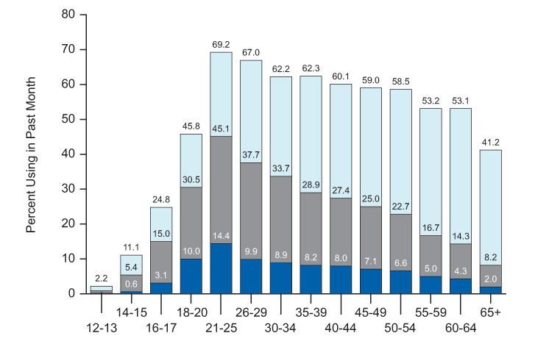
Current, Binge, and Heavy Alcohol Use among Persons aged 12 and older: U.S., 2012
32
SOURCE: SAMHSA, National Survey on Drug Use and Health, 2012 findings.
Notes:
Slightly more than half (52.1%) of Americans aged 12 or older reported being current drinkers of alcohol in the 2012 survey, which was similar to the rate in 2011 (51.8%). This translates to an estimated 135.5 million current drinkers in 2012. Nearly one quarter (23.0%) of persons aged 12 or older in 2012 were binge alcohol users in the 30 days prior to the survey. This translates to about 59.7 million people. The rate in 2012 was similar to the rate in 2011 (22.6%). Looking specifically at the adolescent age group (12-17), 3.2 million 12 to 17 year olds were current alcohol users in 2012 (12.9%).
Additional Information for the Trainer(s)
In 2012, an estimated 56.5% of males aged 12 or older were current drinkers, which was higher than the rate for females (47.9%). However, among youths aged 12 to 17, females were more likely than males to report current alcohol use (see next slide). In 2012, rates of current alcohol use were 2.2% among persons aged 12 or 13, 11.1% of persons aged 14 or 15, 24.8% of 16 or 17 year olds, 45.8% of those aged 18 to 20, and 69.2% of 21 to 25 year olds. These estimates were similar to the rates reported in 2011.
In 2012, heavy drinking was reported by 6.5% of the population aged 12 or older, or 17.0 million people. This percentage was similar to the rate of heavy drinking in 2011 (6.2%).
Rates of binge alcohol use in 2012 were 0.9% among 12 or 13 year olds, 5.4% among 14 or 15 year olds, 15.0% among 16 or 17 year olds, 30.5% among persons aged 18 to 20, and peaked at 45.1% among those aged 21 to 25. These rates were similar to those in 2011 (1.1%, 5.7%, 15.0%, 31.2%, and 45.4%, respectively). The rate of binge drinking in 2012 was 39.5% for young adults aged 18 to 25. Heavy alcohol use was reported by 12.7% of persons aged 18 to 25. These rates were similar to the rates in 2011 (39.8% and 12.1%, respectively).
NSDUH DEFINITIONS
Binge alcohol use = Five (5) or more drinks on the same occasion (at the same time or within a couple of hours of each other) on at least one day in the past 30 days.
Heavy alcohol use = Binge drinking on five or more days in the past 30.

Slide 33
Gender and Racial/Ethnic Differences in Current Alcohol Use: U.S., 2012
Percentage
33
SOURCE: SAMHSA, National Survey on Drug Use and Health, 2012 findings.
Notes:
Among youth aged 12 to 17, females were slightly more likely to self-report current drinking than their male counterparts (13.2% vs. 12.6%). With regards to racial/ethnic differences, Asians/Pacific Islanders had lower rates of current alcohol use than any other racial/ethnic group (4.9%). Rates of current alcohol use for youth in other racial/ethnic groups were 9.3% for African Americans, 10.0% for American Indians or Alaska Natives, 11.7% for those reporting two or more races, 12.8% for Hispanics/Latinos, and 14.6% for Whites.

Slide 34
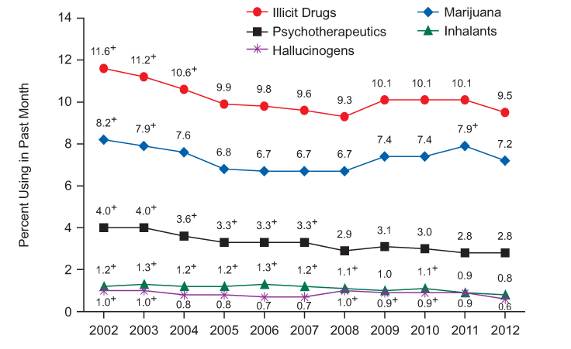
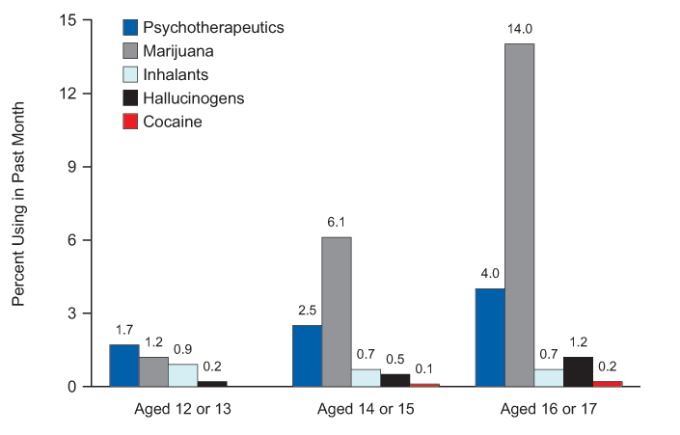
Past Month Illicit Drug Use among Youth (12-17 year olds): U.S., 2002-2012
34
SOURCE: SAMHSA, National Survey on Drug Use and Health, 2012 findings.
Notes:
**ANIMATION**
This slide includes two graphs, which have been animated so that the second graph appears 20 seconds after the first graph. If you need more time to describe the first graph, you can go into the animation pane and increase the delay to greater than 20 seconds.
First Graph: In 2012, 7.2% of youth aged 12 to 17 were current users of marijuana, 2.8% were current nonmedical users of psychotherapeutic drugs, 0.8% were current users of inhalants, 0.6% were current users of hallucinogens, and 0.1% were current users of cocaine.
Second Graph: Among youth aged 12 to 17, the specific types of illicit drugs used in the past month varied by age in 2012. Among 12 or 13 year olds, 1.7% used psychotherapeutic drugs non-medically (with 1.5% using pain relievers non-medically), 1.2% used marijuana, and 0.9% used inhalants. Among 14 or 15 year olds, 6.1% used marijuana, 2.5% used psychotherapeutic drugs non-medically (with 2.2% using pain relievers non-medically), 0.7% used inhalants, and 0.5% used hallucinogens. Among 16 or 17 year olds, 14.0% used marijuana, 4.0% used psychotherapeutic drugs non-medically (with 3.1% using pain relievers non-medically), 1.2% used hallucinogens, 0.7% used inhalants, and 0.2% used cocaine. The percentage of youths aged 16 or 17 in 2012 who were current users of cocaine was lower than in 2011 (0.5%).
In summary, 12-13 year olds were most likely to use prescription medications non medically; and 14-15 and 16-17 year olds were most likely to report current marijuana use.

Slide 35
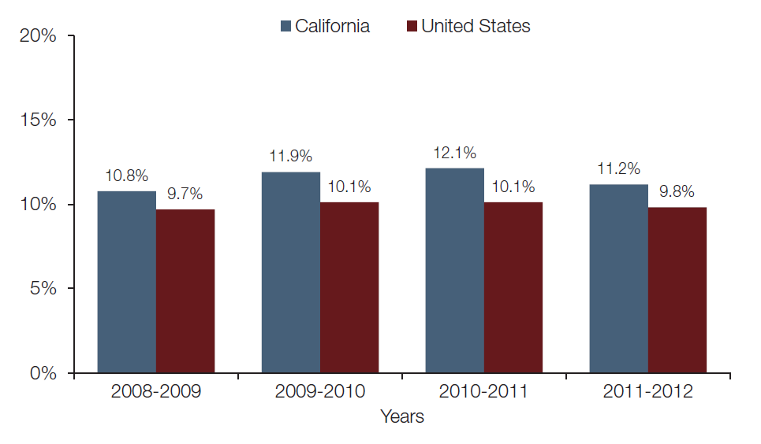
Past Month Illicit Drug Use among 12-17 Year Olds – CA vs. U.S. (2008-2012)
35
SOURCE: SAMHSA, Behavioral Health Barometer (based on NSDUH 2008-2012 results).
Notes:
In California, about 353,000 youth (11.2% of all youth) in 2011-2012 reported using illicit drugs within the month prior to being surveyed. California’s rate of illicit drug use among youth was higher than the national rate in 2011-12.
Additional Information for the Trainer(s)
Among 12-17 year-olds in California, the mean age of first use of a variety of substances was as follows: 13.8 for marijuana, 13.4 years for the nonmedical use of psychotherapeutics, 13.2 years for cigarettes, and 13.4 years for alcohol.

Slide 36
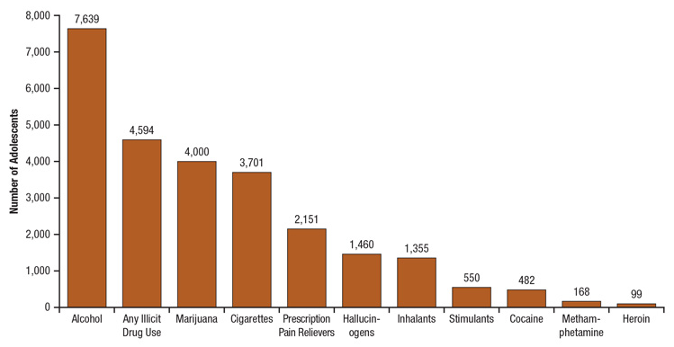
Number of Adolescents aged 12 to 17** who Used Cigarettes, Alcohol, or Illicit Drugs for the First Time on an Average Day: 2010-2011
**National Survey Data
36
SOURCE: SAMHSA, CBHSQ Report, August 29, 2013.
Notes:
The Center for Behavioral Health Statistics and Quality (CBHSQ) in the Substance Abuse and Mental Health Services Administration (SAMHSA) collects, analyzes, and disseminates critical public health data. CBHSQ manages four national data collections that offer insight into adolescent substance use and treatment: the National Survey on Drug Use and Health (NSDUH), the Treatment Episode Data Set (TEDS), the National Survey of Substance Abuse Treatment Services (N-SSATS), and the Drug Abuse Warning Network (DAWN). The August 29, 2013 CBHSQ Report presents facts about adolescent substance use, including initiation, receipt of treatment, and emergency department visits for substance use "on an average or typical day." Data in this report from NSDUH, TEDS, and DAWN are for adolescents aged 12 to 17; data from N-SSATS are for youths aged 17 or younger.
In the United States in 2011, there were an estimated 25.1 million adolescents aged 12 to 17. In the past year, more than one quarter of adolescents drank alcohol, approximately one-fifth used an illicit drug, and almost one-eighth smoked cigarettes. According to combined 2010 and 2011 NSDUH data, 10.3% of adolescents aged 12 to 17 drank alcohol for the first time in the past year, and 6.3% used an illicit drug for the first time. The combined 2010 and 2011 NSDUH data indicate that, on any given day (average day) during the past year, the following numbers of adolescents used the indicated using a substance for the first time: 7,639 used alcohol, 4,594 used any illicit drug, 4,000 used marijuana, 3,701 used cigarettes, 2,151 used prescription pain relievers, 1,460 used a hallucinogen, 1,355 used an inhalant, 550 used stimulants, 482 used cocaine, 168 used methamphetamine, and 99 used heroin.
Additional Information for the Trainer(s)
With regards to past year use, according to combined 2010 and 2011 NSDUH data, nearly 7 million adolescents aged 12 to 17 drank alcohol, nearly 5 million used an illicit drug, and 3 million smoked cigarettes. The figure includes the past year numbers for specific substances. The combined 2010 and 2011 NSDUH data indicate that adolescents who used alcohol in the past month drank an average of 4.3 drinks per day on the days they drank, and adolescents who smoked cigarettes in the past month smoked an average of 3.9 cigarettes per day on the days they smoked.

Slide 37
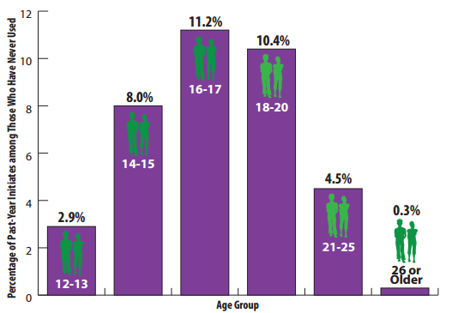
The Drug Danger Zone: Most Illicit Drug Use Starts in Teenage Years
37
SOURCE: NIDA. (2014). Drugs, Brains, and Behavior: The Science of Addiction.
Notes:
According to data from the 2011 and 2012 NSDUH, most illicit drug use starts in the teenage years, with use starting as young as 12-13 years of age (or younger).

Slide 38
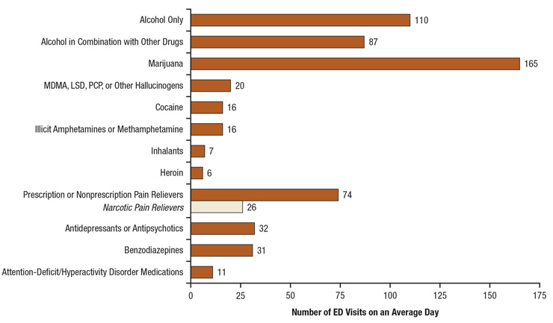
Number of Emergency Department (ED) Visits for Drug Misuse or Abuse on a Typical Day for Patients Aged 12 to 17, by Selected Types of Drugs: U.S., 2011
38
SOURCE: SAMHSA, CBHSQ Report, August 29, 2013.
Notes:
The Drug Abuse Warning Network (DAWN) estimates that in 2011 there were about 280,000 drug-related ED visits by adolescents aged 12 to 17, of which 181,005 visits involved the use of illicit drugs, alcohol, or intentional misuse or abuse of pharmaceuticals (e.g., prescription medicines, over-the-counter remedies, and dietary supplements). On a typical day in 2011, there were 777 drug-related ED visits for adolescents aged 12 to 17, of which 496 involved the use of illegal drugs or the misuse or abuse of pharmaceuticals. On a typical day in 2011, the listed substances were involved at the following levels. DAWN estimates that, on any given day in 2011, there were 63 ED visits for drug-related suicide attempts among adolescents.

Slide 39

Who’s Presenting for Substance Use Disorder Treatment?
39
Notes:
The next series of slides will look specifically at substance use disorder treatment admission rates among adolescents and young adults.

Slide 40
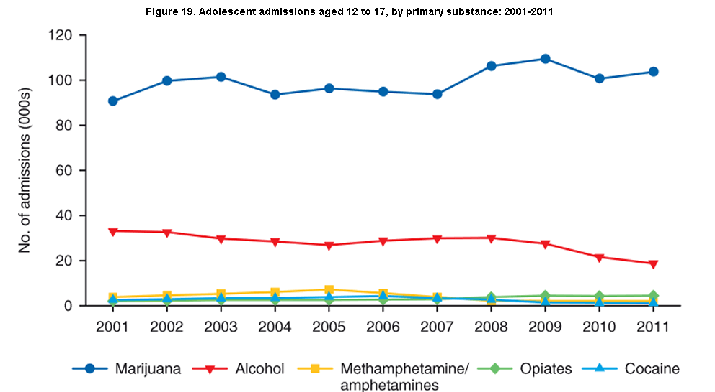
National Treatment Data: Adolescent Admissions by Primary Substance of Abuse: 2001-2011
40
SOURCE: SAMHSA, Treatment Episode Data Set, 2001-2011 results.
Notes:
The Treatment Episode Data Set (TEDS) reported that in 2010, there were 132,850 admissions for adolescents aged 12 to 17 to substance use disorder treatment programs. Two primary substances—marijuana and alcohol—accounted for between 83% and 89% of adolescent admissions from 2001 to 2011.
Marijuana admissions increased from 62 percent of adolescent admissions in 2001 to 75 percent in 2011. The number of adolescent marijuana admissions increased by 14 percent between 2001 and 2011. Alcohol admissions declined from 23 percent of adolescent admissions in 2001 to 14 percent in 2011. Methamphetamine/ amphetamine admissions increased from 3 percent in 2001 to 6 percent in 2005, but then decreased to 2 percent in 2011. Opiate admissions represented 1 to 2 percent of adolescent admissions from 2001 to 2008 but rose to 3 percent in 2009 where it remained in 2011. Opiates other than heroin² represented 29 percent of adolescent opiate admissions in 2001 but rose to 66 percent in 2011. Cocaine accounted for between 2 and 3 percent of adolescent admissions between 2001 and 2008. Beginning in 2009, cocaine accounted for 1 percent of adolescent admissions. All other substances combined accounted for 2 to 3 percent of adolescent admissions between 2001 and 2011.
Additional Information for the Trainer(s)
TEDS indicates that, on a typical day in 2010, adolescent admissions to treatment reported the following primary substances of abuse: 266 reported marijuana; 58 reported alcohol; 12 reported heroin or other opiates; 10 reported stimulants; 3 reported cocaine; and 8 reported other drugs. In addition, substance use disorder treatment admissions were referred principally by the following sources: 163 by the criminal justice system; 62 by self-referral or referral from other individuals; 49 by schools; 44 by community organizations; 23 by alcohol/drug abuse care providers; and 17 by other health care providers. Lastly, N-SSATS, which collects information on substance use disorder treatment at both publicly and privately funded facilities, reports how many active clients aged 17 or younger received the following types of substance use disorder treatment on a typical day in 2010: 71,303 were clients in outpatient treatment; 9,302 were clients in non-hospital residential treatment; and 1,258 were clients in hospital inpatient treatment.

Slide 41
Adolescent Treatment Admissions by Gender: U.S., 2011
41
SOURCE: SAMHSA, Treatment Episode Data Set, 2011 results.
Notes:
According to the 2010 data from TEDS, a higher percentage of males were admitted to treatment for abuse of all substances, with the exception of methamphetamine/amphetamine admissions, which were dominated by females (55.5% female vs. 44.5% male).

Slide 42
Adolescent Treatment Admissions by Race/Ethnicity: U.S., 2011
42
SOURCE: SAMHSA, Treatment Episode Data Set, 2011 results.
Notes:
In 2012, the racial/ethnic breakdown of the general U.S. population was as follows: Whites (60.3%); Hispanics/Latinos (16.9%); African Americans (13.1%); Asians/Pacific Islanders (5.3%); and American Indian/Alaska Native (1.2%). According to the 2010 TEDS treatment admissions data, African Americans and Hispanics/Latinos were over-represented among all substance use disorder treatment admissions. The racial/ethnic breakdown for alcohol and the main drugs of abuse are highlighted in the figure.

Slide 43
HIV Surveillance in
Adolescents and
Young Adults
National Center for HIV/AIDS, Viral Hepatitis, STD & TB Prevention
43
Division of HIV/AIDS Prevention
Notes:
Estimated numbers and rates of diagnosed HIV infection and diagnosed infections classified as stage 3 (AIDS) are based on data from 50 states, the District of Columbia, and 6 U.S. dependent areas. Rates are not calculated by race/ethnicity for the 6 U.S. dependent areas because the U.S. Census Bureau does not collect information from all U.S. dependent areas.

Slide 44
Unlike adults, the rate of HIV infection among adolescents is spread fairly evenly across the U.S.
Strongly disagree
Disagree
Neutral
Agree
Strongly Agree
44
Notes:
INSTRUCTIONS
Read the question and choices, and review audience responses out loud.

Slide 45
Diagnoses of HIV Infection among Adolescents and Young Adults Aged 13-24 Years, by Race/Ethnicity, 2008-2011 (U.S. and 6 Dependent Areas)
Note. Data include persons with a diagnosis of HIV infection regardless of stage of disease at diagnosis. All displayed data have been statistically adjusted to account for reporting delays, but not for incomplete reporting.
ª Hispanics/Latinos can be of any race.
45
Notes:
During 2008 through 2011, blacks/African Americans accounted for more than 55% of diagnoses of HIV infection each year among adolescents and young adults aged 13 to 24 years in the United States and 6 dependent areas. In 2011, of persons aged 13 to 24 years diagnosed with HIV infection, 60% were black/African American, 18% were white, 19% were Hispanic/Latino, 2% were persons of multiple races, 1% each were Asian and American Indian/Alaska Native, and less than 1% were Native Hawaiian/other Pacific Islander.
The racial/ethnic distribution of diagnoses of HIV infection in persons aged 13 to 24 years differs substantially from the distribution of diagnoses among all adults and adolescents (aged 13 and over) in 2010. Among all adults and adolescents diagnosed with HIV infection in 2009, 45% were black/African American, 29% were white, 22% were Hispanic/Latino, 2% were Asian, 1% were of multiple races, and less than 1% each were American Indian/Alaska Native and Native Hawaiian/other Pacific Islander.
Data include persons with a diagnosis of HIV infection regardless of stage of disease at diagnosis. All displayed data are estimates. Estimated numbers resulted from statistical adjustment that accounted for reporting delays, but not for incomplete reporting.
Hispanics/Latinos can be of any race.

Slide 46
Diagnoses of HIV Infection among Adolescents and Young Adults Aged 13-24 Years, by Transmission Category, 2008-2011 (U.S. and 6 Dependent Areas)
Note. Data include persons with a diagnosis of HIV infection regardless of stage of disease at diagnosis. All displayed data have been statistically adjusted to account for reporting delays and missing transmission category, but not for incomplete reporting.
ª Heterosexual contact with a person known to have, or to be at high risk for, HIV infection.
^{b} Includes hemophilia, blood transfusion, perinatal exposure, and risk factor not reported or not identified.
46
Notes:
This slide presents the percentage distribution of diagnoses of HIV infection by transmission category for adolescents and young adults 13 to 24 years of age diagnosed from 2008 through 2011 in the United States and 6 dependent areas.
Among adolescents and young adults, the estimated percentage of diagnosed HIV infections attributed to male-to-male sexual contact increased from 70% in 2008 to 77% in 2011. The percentage of diagnosed HIV infections attributed to heterosexual contact decreased from 23% to 18% during this time. The percentage of diagnosed HIV infections attributed to injection drug use also decreased slightly, from 4% to 3%. The percentage of diagnosed HIV infections attributed to male-to-male sexual contact and injection drug use remained relatively stable from 2008 through 2011.
The remaining diagnoses of HIV infection were those attributed to hemophilia, blood transfusion, perinatal exposure, and those in persons without an identified risk factor.
Data include persons with a diagnosis of HIV infection regardless of stage of disease at diagnosis. All displayed data are estimates. Estimated numbers resulted from statistical adjustment that accounted for reporting delays and missing transmission category, but not for incomplete reporting.
Heterosexual contact is with a person known to have, or to be at high risk for, HIV infection.

Slide 47
Diagnoses of HIV Infection and Population among Adolescents Aged 13-19 Years, by Race/Ethnicity 2011 (U.S.)
Note. Data include persons with a diagnosis of HIV infection regardless of stage of disease at diagnosis. All displayed data have been statistically adjusted to account for reporting delays, but not for incomplete reporting.
ª Hispanics/Latinos can be of any race.
47
Notes:
Black/African American adolescents aged 13 to 19 years have been disproportionately affected by HIV. In 2011, in the United States, 15% of adolescents were black/African American, yet an estimated 67% of diagnoses of HIV infection in 13 to 19 year olds were in black/African American adolescents.
Data include persons with a diagnosis of HIV infection regardless of stage of disease at diagnosis. All displayed data are estimates. Estimated numbers resulted from statistical adjustment that accounted for reporting delays, but not for incomplete reporting.
Hispanics/Latinos can be of any race.

Slide 48
Diagnoses of HIV Infection and Population among Young Adults Aged 20-24 Years, by Race/Ethnicity 2011 (U.S.)
Note. Data include persons with a diagnosis of HIV infection regardless of stage of disease at diagnosis. All displayed data have been statistically adjusted to account for reporting delays, but not for incomplete reporting.
ª Hispanics/Latinos can be of any race.
48
Notes:
Black/African American young adults aged 20 to 24 years have been disproportionately affected by HIV. In 2011, in the United States, 14% of young adults were black/African American, yet an estimated 58% of diagnoses of HIV infection in 20 to 24 year olds were in blacks/African Americans.
Data include persons with a diagnosis of HIV infection regardless of stage of disease at diagnosis. All displayed data are estimates. Estimated numbers resulted from statistical adjustment that accounted for reporting delays, but not for incomplete reporting.
Hispanics/Latinos can be of any race.

Slide 49
Diagnoses of HIV Infection among Persons Aged 13 Years and Older, by Sex and Age Group, 2011
(U.S. and 6 Dependent Areas)
Note. Data include persons with a diagnosis of HIV infection regardless of stage of disease at diagnosis. All displayed data have been statistically adjusted to account for reporting delays, but not for incomplete reporting.
49
Notes:
In 2011, the percentage distribution of diagnoses of HIV infection by sex varied with age group at diagnosis in the United States and 6 dependent areas. In 2011, females accounted for an estimated 14% of young adults aged 20 to 24 years diagnosed with HIV infection, compared with 23% of adolescents aged 13 to 19 years and 22% of adults aged 25 years and older.
Data include persons with a diagnosis of HIV infection regardless of stage of disease at diagnosis. All displayed data are estimates. Estimated numbers resulted from statistical adjustment that accounted for reporting delays, but not for incomplete reporting. Age group assigned based on age at diagnosis.

Slide 50
Diagnoses of HIV Infection among Adolescent and Young Adult Males, by Age Group and Transmission Category 2011 (U.S. and 6 Dependent Areas)
 | 13–19 years |  |  | 20–24 years
Transmission category | No. | % |  | No. | %
Male-to-male sexual contact | 1,664 | 92.8 |  | 6,354 | 90.8
Injection drug use (IDU) | 23 | 1.4 |  | 117 | 1.7
Male-to-male sexual contact and IDU | 37 | 2.1 |  | 232 | 3.3
Heterosexual contactª | 67 | 3.7 |  | 294 | 4.2
Other^{b} | 0 | 0.0 |  | 0 | 0.0
Total | 1,794 | 100 |  | 6,998 | 100
Note. Data include persons with a diagnosis of HIV infection regardless of stage of disease at diagnosis. All displayed data have been statistically adjusted to account for reporting delays and missing transmission category, but not for incomplete reporting.
ª Heterosexual contact with a person known to have, or to be at high risk for, HIV infection.
^{b} Includes hemophilia, blood transfusion, perinatal exposure, and risk factor not reported or not identified.
50
Notes:
This slide shows the estimated numbers and percentages of diagnoses of HIV infection among adolescent males aged 13 to 19 years and young adult males aged 20 to 24 years in 2011 in the United States and 6 dependent areas. In 2011, in both age groups, the majority of diagnosed HIV infections were attributed to male-to-male sexual contact: 93% of diagnoses in males aged 13 to 19 years, and 91% of diagnoses in males aged 20 to 24 years.
Data include persons with a diagnosis of HIV infection regardless of stage of disease at diagnosis. All displayed data are estimates. Estimated numbers resulted from statistical adjustment that accounted for reporting delays and missing transmission category, but not for incomplete reporting.
Heterosexual contact is with a person known to have, or to be at high risk for, HIV infection.

Slide 51
Diagnoses of HIV Infection among Adolescent and Young Adult Females, by Age Group and Transmission Category 2011 (U.S. and 6 Dependent Areas)
 | 13–19 years |  |  | 20–24 years
Transmission category | No. | % |  | No. | %
Injection drug use | 37 | 7.0 |  | 101 | 8.8
Heterosexual contactª | 485 | 92.7 |  | 1,041 | 91.2
Other^{b} | 0 | 0.3 |  | 0 | 0.0
Total | 523 | 100 |  | 1,142 | 100
Note. Data include persons with a diagnosis of HIV infection regardless of stage of disease at diagnosis. All displayed data have been statistically adjusted to account for reporting delays and missing transmission category, but not for incomplete reporting.
ª Heterosexual contact with a person known to have, or to be at high risk for, HIV infection.
^{b} Includes blood transfusion, perinatal exposure, and risk factor not reported or not identified.
51
Notes:
This slide shows the estimated numbers and percentages of diagnoses of HIV infection among adolescent females aged 13 to 19 years and young adult females aged 20 to 24 years in 2011 in the United States and 6 dependent areas. In 2011, in both age groups, the majority of diagnosed HIV infections were attributed to heterosexual contact: 93% in females aged 13 to 19 years, and 91% in females aged 20 to 24 years.
Data include persons with a diagnosis of HIV infection regardless of stage of disease at diagnosis. All displayed data are estimates. Estimated numbers resulted from statistical adjustment that accounted for reporting delays and missing transmission category, but not for incomplete reporting.
Heterosexual contact is with a person known to have, or to be at high risk for, HIV infection.

Slide 52
Rates of Diagnoses of HIV Infection among Adolescents Aged 13-19 Years, 2011 (U.S. and 6 Dependent Areas)
N = 2,316 Total Rate = 7.6
Note. Data include persons with a diagnosis of HIV infection regardless of stage of disease at diagnosis. All displayed data have been statistically adjusted to account for reporting delays, but not for incomplete reporting.
52
Notes:
In 2011, there were an estimated 2,316 adolescents aged 13 to 19 years diagnosed with HIV infection in the United States and 6 dependent areas. The estimated rate of diagnoses of HIV infection in adolescents was 7.6 per 100,000 population. The rates of diagnoses of HIV infection among adolescents aged 13 to 19 years in 2011 were highest in the District of Columbia (74.6 per 100,000), Louisiana (22.1 per 100,000), Maryland (17.6 per 100,000), Florida (13.5 per 100,000), and the U.S. Virgin Islands (13.4 per 100,000).
The District of Columbia (i.e., Washington, DC) is a city; please use caution when comparing the HIV diagnosis rate in DC with the rates in states.
Data include persons with a diagnosis of HIV infection regardless of stage of disease at diagnosis. All displayed data are estimates. Estimated numbers resulted from statistical adjustment that accounted for reporting delays, but not for incomplete reporting.

Slide 53
Rates of Diagnoses of HIV Infection among Young Adults Aged
20-24 Years, 2011 (U.S. and 6 Dependent Areas)
N = 8,140 Total Rate = 36.3
Note. Data include persons with a diagnosis of HIV infection regardless of stage of disease at diagnosis. All displayed data have been statistically adjusted to account for reporting delays, but not for incomplete reporting.
53
Notes:
In 2011, there were an estimated 8,140 young adults aged 20 to 24 years diagnosed with HIV infection in the United States and 6 dependent areas. The estimated rate of diagnoses of HIV infection in young adults was 36.3 per 100,000 population. With the exception of the U.S Virgin Islands (74.1 per 100,000), New York (51.2 per 100,000), and Illinois (42.7 per 100,000), the rates of diagnoses of HIV infection among young adults 20 to 24 years of age in 2011 were highest in the South; specifically, the District of Columbia (172.6 per 100,100), Maryland (77.0 per 100,000), Georgia (72.7 per 100,000), Louisiana (69.8 per 100,000), Mississippi (62.1 per 100,000), Alabama (56.3 per 100,000), South Carolina, (55.6 per 100,000), Florida (55.3 per 100,000), Texas (49.5 per 100,000), Tennessee (42.5 per 100,000), and North Carolina (41.2 per 100,000).
The District of Columbia (i.e., Washington, DC) is a city; please use caution when comparing the HIV diagnosis rate in DC with the rates in states.
Data include persons with a diagnosis of HIV infection regardless of stage of disease at diagnosis. All displayed data are estimates. Estimated numbers resulted from statistical adjustment that accounted for reporting delays, but not for incomplete reporting.

Slide 54
Stage 3 (AIDS) Classifications among Persons Aged 13 Years and Older with HIV Infection, by Race/Ethnicity and Age Group
2011 (U.S. and 6 Dependent Areas)
Note. All displayed data have been statistically adjusted to account for reporting delays, but not for incomplete reporting.
ª Includes Asian/Pacific Islander legacy cases.
^{b} Hispanics/Latinos can be of any race.
54
Notes:
This slide compares the racial/ethnic percentage distributions of stage 3 (AIDS) classifications in adolescents 13-19 years of age, young adults 20-24 years of age, and adults 25 years and over diagnosed during 2011 in the United States and 6 dependent areas. In all three age groups, blacks/African Americans had the largest percentage of stage 3 (AIDS) classifications, although the percentage decreased as age group increased: 66% in persons aged 13 to 19 years, 64% in persons aged 20 to 24 years, and 48% in persons aged 25 years and over. While Hispanics/Latinos accounted for relatively similar percentages of stage 3 (AIDS) classifications in all three age groups, they represented the second largest percentage of persons 13-19 years (21%) and persons 20-24 years (18%) and the third largest percentage of persons among adults over 25 years of age (21%). The percentage of stage 3 (AIDS) classifications among whites in 2011 increased as age group increased: 10% in persons aged 13 to 19 years, 13% in persons aged 20 to 24 years, and 27% in persons aged 25 years and over.
All displayed data are estimates. Estimated numbers resulted from statistical adjustment that accounted for reporting delays, but not for incomplete reporting. Age group assigned based on age at stage 3 (AIDS) classification.
The Asian category includes Asian/Pacific Islander legacy cases (cases that were diagnosed and reported under the pre-1997 Office of Management and Budget race/ethnicity classification system).
Hispanics/Latinos can be of any race.

Slide 55

The Intersection of Substance Use and HIV/AIDS Among Youth
55
Notes:
TRANSITION SLIDE
Young people are frequently at the center of the HIV epidemic, and HIV has been referred to as a “youth-driven disease” worldwide (1). Almost half of all new HIV infections worldwide are among youth aged 15–24 years (2). In the United States, 40% of all HIV infections occur in persons under 25 years of age, and HIV is the sixth leading cause of death among adolescents (1). In addition, adolescence and young adulthood is often the time when alcohol and drug experimentation begins, which may put young substance users at high-risk for HIV and other sexually transmitted infections. Substance use impairs judgment and decision-making, and some drugs (e.g., stimulants) may heighten perception of sexual arousal and promote high-risk sexual activity (3).
According to CDC estimates, in 2011, more than 10,000 young people, aged 13 to 24 were diagnosed with HIV, and over 2,900 were diagnosed with AIDS in the U.S. In the past, most of those cases were in adolescent males. That ratio is changing, as more females become infected.
REFERENCES
(1) Benton T., & Ifeagwu J. (2008). HIV in adolescents: What we know and need to know. Current Psychiatry Reports, 10, 109-115.
(2) UNAIDS. (2008). Report on the Global AIDS Epidemic. Geneva: UNAIDS.
(3) Rotheram-Borus, M.J., Ingram, B.K., Swendeman, D., & Flannery, D. (2009). Common principles embedded in effective adolescent HIV prevention programs. AIDS Behavior, 13(3), 387-398.

Slide 56

Substance Abuse and HIV/AIDS: What’s the Link?
Substance abuse and addiction have been closely linked with HIV/AIDS since the beginning of the epidemic
  Injection Drug Use
  Poor judgment and risky
  behavior
  Biological effects of drugs
  Substance use disorder
  treatment as HIV prevention
56
SOURCE: National Institute on Drug Abuse. (2014). Drug Facts: HIV/AIDS and Drug Abuse.
Notes:
Typically, people associate drug abuse and HIV/AIDS with injection drug use and needle sharing. Drug abuse by any method (not just injection) can put a person at risk for contracting HIV. Drug and alcohol intoxication affect the way a person makes decisions and can lead to unsafe sexual practices, which puts them at risk for getting HIV or transmitting it to someone else. Drug abuse and addiction can worsen the progression of HIV and its consequences, especially in the brain. Since the late 1980s, researchers have found that if you treat substance use disorders, you can prevent the spread of HIV. When people who have a substance problem enter treatment, they stop or reduce their alcohol and/or drug use and related risk behaviors, including drug injection and unsafe sexual practices. SUD treatment programs also serve an important role in getting out good information on HIV/AIDS and related diseases, providing counseling and testing services, and offering referrals for medical and social services.
REFERENCE
National Institute on Drug Abuse. (2014). Drug Facts: HIV/AIDS and Drug Abuse. Available at: http://teens.drugabuse.gov/drug-facts/hiv-aids-and-drug-abuse.

Slide 57

Predicting Substance Abuse Among Youth with or At-Risk for HIV
What attributes best predict substance abuse?
  Among males: younger, HIV positive, homeless, involved in the criminal justice system, positive for an STD, engaging in survival sex, and participating in risky sex with men, women, and/or IDUs
  Among females, the same predictors were significant, with the exception of having an STD
57
SOURCE: Huba et al., 2000.
Notes:
Substance abuse is a major issue for many young people who are living with, or are at high risk for HIV. Many factors, such as unprotected sexual behaviors and substance abuse, place an individual at increased risk for HIV infection, many of those same issues are part of a generalized constellation of problem behaviors that place a youth at risk for substance abuse. Huba and colleagues found that among HIV-positive and at-risk youth, several characteristics were predictive of substance abuse. Youth who were HIV positive, younger, Hispanic, or multiracial were more likely to have a substance abuse problem. Among the females, those who were Native American were also more likely to be substance abusers. In terms of other related risk behaviors, both males and females who were noted to have had risky sex with men, risky sex with women, sex with an injection drug user, survival sex, or those who were homeless or involved in the criminal justice system were more likely to also be substance abusers. Among the males, those with a history of an STD and having had an HIV-positive sex partner were also more likely
to be substance abusers, as were females who were not involved with the mental health service system.
Additional Information for the Trainer(s)
In one study, Alperen and colleagues conducted a cross-sectional and longitudinal analysis to examine the risk factors associated with recent substance use among perinatally human immunodeficiency virus (HIV)-infected (PHIV+) and perinatally exposed, uninfected (PHEU) youth and compared SU lifetime prevalence with the general population of United States adolescents. Perinatal HIV infection was not a statistically significant risk factor for alcohol or marijuana use. Risk factors for alcohol use among PHIV+ youth included higher severity of emotional and conduct problems and alcohol and marijuana use in the home by the caregiver or others. Risk factors for marijuana use among PHIV+ youth included marijuana use in the home, higher severity of conduct problems, and stressful life events. Similar SU risk factors among PHEU youth included SU in the home and higher severity of conduct and emotional problems. Overall lifetime prevalence of SU by age was similar to that in national surveys. Although lifetime substance use prevalence and risk factors for PHIV+ and PHEU adolescents were similar to national norms, the negative consequences are potentially greater for PHIV+ youth. Prevention efforts should begin before substance use initiation and address the family and social environment and youth mental health status.
REFERENCES
(1) Huba et al. (2000). Psychology of Addictive Behaviors, 14(2), 197-205.
(2) Alperen et al. (2012). Fourth International Workshop on HIV Pediatrics, Washington, DC, July 20–21, 2012.

Slide 58
Gender Differences in the Relationship between Traumatic Stress, Substance Use, and HIV Risk
Significant differences between males and females, and between those reporting low versus acute traumatic stress (TS)
  Females and those with acute levels of TS symptoms had higher levels of substance use, mental health, and physical health problems as well as greater HIV risk behaviors when compared to males and those with low levels of TS symptoms
58
SOURCE: Stevens et al., 2003.
Notes:
Research on traumatic stress (TS) among adolescent substance users is limited, with research indicating that not all adolescents who experience trauma are substance users and
not all adolescent substance users report symptoms of TS. In the general adolescent population, research on TS symptoms indicates gender differences, with more females reporting traumatic life events and more symptoms associated with traumatic stress. A gap in research exists, however, with regard to gender differences among adolescent substance users who report low versus acute levels of TS symptoms. In a study by Stevens and colleagues, 274 male and 104 female adolescents enrolled in four drug treatment programs in Arizona were assessed. Comparisons between males and females and those with low versus acute levels of TS symptoms were examined with regard to substance
use, mental health, physical health, and HIV risk-taking behavior. Results indicate significant differences between males and females and between those reporting low versus acute TS. In general, females and those with acute levels of TS symptoms had higher levels of substance use, mental health, and physical health problems as well as greater HIV risk behaviors when compared to males and those with low levels of TS symptoms. Results of this study indicate the need to assess adolescents for TS, including victimization and maltreatment histories, when entering substance abuse treatment and the need to simultaneously address issues of substance use, TS, and related mental health, physical health, and HIV sex risk behavior while in treatment.
REFERENCE
Stevens, S.J., Murphy, B.S., & McKnight, K. (2003). Traumatic stress and gender differences in relationship to substance abuse, mental health, physical health, and HIV risk behavior in a sample of adolescents enrolled in drug treatment. Child Maltreatment, 8(1), 46-57.

Slide 59

HIV Risk Factors and
Barriers to Prevention
Sexual Risk Factors
  Early age at sexual initiation
  Heterosexual transmission
  MSM
  Other STDs
Substance Abuse
Lack of Awareness
Poverty and Out-of-School Youth
Coming of Age of HIV-Positive Children
59
SOURCE: CDC. (2008). CDC HIV/AIDS Fact Sheet: HIV/AIDS among Youth.
Notes:
Early age at sexual initiation: According to CDC’s Youth Risk Behavioral Survey (YRBS), many young people begin having sexual intercourse at early ages: 47% of high school students have had sexual intercourse, and 7.4% of them reported first sexual intercourse before age 13 [4]. HIV/AIDS education needs to take place at correspondingly young ages, before young people engage in sexual behaviors that put them at risk for HIV infection.
Heterosexual transmission: Young women, especially those of minority races or ethnicities, are increasingly at risk for HIV infection through heterosexual contact. According to data from a CDC study of HIV prevalence among disadvantaged youth during the early to mid-1990s, the rate of HIV prevalence among young women aged 16–21 was 50% higher than the rate among young men in that age group [5]. African American women in this study were 7 times as likely as white women and 8 times as likely as Hispanic women to be HIV-positive. Young women are at risk for sexually transmitted HIV for several reasons, including biologic vulnerability, lack of recognition of their partners’ risk factors, inequality in relationships, and having sex with older men who are more likely to be infected with HIV.
MSM: Young MSM are at high risk for HIV infection, but their risk factors and the prevention barriers they face differ from those of persons who become infected through heterosexual contact. According to a CDC study of 5,589 MSM, 55% of young men (aged 15–22) did not let other people know they were sexually attracted to men [6]. MSM who do not disclose their sexual orientation are less likely to seek HIV testing, so if they become infected, they are less likely to know it. Further, because MSM who do not disclose their sexual orientation are likely to have 1 or more female sex partners, MSM who become infected may transmit the virus to women as well as to men. In a small study of African American MSM college students and nonstudents in North Carolina, the participants had sexual risk factors for HIV infection, and 20% had a female sex partner during the preceding 12 months [7].
Sexually transmitted diseases (STDs): The presence of an STD greatly increases a person’s likelihood of acquiring or transmitting HIV [8]. Some of the highest STD rates in the country are those among young people, especially young people of minority races and ethnicities [9].
Substance Use: Young people in the United States use alcohol, tobacco, and other drugs at high rates [10]. Both casual and chronic substance users are more likely to engage in high-risk behaviors, such as unprotected sex, when they are under the influence of drugs or alcohol [11]. Runaways and other homeless young people are at high risk for HIV infection if they are exchanging sex for drugs or money.
Lack of Awareness: Research has shown that a large proportion of young people are not concerned about becoming infected with HIV [12]. Adolescents need accurate, age-appropriate information about HIV infection and AIDS, including how to talk with their parents or other trusted adults about HIV and AIDS, how to reduce or eliminate risk factors, how to talk with a potential partner about risk factors, where to get tested for HIV, how to use a condom correctly. Information should also include the concept that abstinence is the only 100% effective way to avoid infection.
Poverty and Out-of-School Youth: Nearly 1 in 4 African Americans and 1 in 5 Hispanics live in poverty [13]. The socioeconomic problems associated with poverty, including lack of access to high-quality health care, can directly or indirectly increase the risk for HIV infection [14]. Young people who have dropped out of school are more likely to become sexually active at younger ages and to fail to use contraception [15].
The Coming of Age of HIV-Positive Children: Many young people who contracted HIV through perinatal transmission are facing decisions about becoming sexually active. They will require ongoing counseling and prevention education to ensure that they do not transmit HIV.
REFERENCES
CDC. (2005). HIV/AIDS Surveillance Report, 2004. Vol. 16. Atlanta: US Department of Health and Human Services.
(2) CDC. (2005). HIV Prevention in the Third Decade. Atlanta: US Department of Health and Human Services.
(3) CDC. (2001). HIV incidence among young men who have sex with men—seven US cities, 1994–2000. MMWR, 50, 440-444.
(4) CDC. (2004). Youth Risk Behavior Surveillance―United States, 2003. MMWR, 53(SS-2), 1-29.
(5) Valleroy, L.A., MacKellar, D.A., Karon, J.M., Janssen, R.S., & Hayman, D.R. (1998). HIV infection in disadvantaged out-of-school youth: prevalence for U.S. Job Corps entrants, 1990 through 1996. Journal of Acquired Immune Deficiency Syndromes, 19, 67-73.
(6) CDC. (2003). HIV/STD risks in young men who have sex with men who do not disclose their sexual orientation—six US cities, 1994–2000. MMWR, 52, 81-85.
(7) CDC. (2003). HIV transmission among black college student and non-student men who have sex with men―North Carolina, 2003. MMWR, 53, 731-734.
(8) Fleming, D.T., & Wasserheit, J.N. (1999). From epidemiological synergy to public health policy and practice: The contribution of other sexually transmitted diseases to sexual transmission of HIV infection. Sexually Transmitted Infections, 75, 3-17.
(9) CDC. (2005). Sexually Transmitted Disease Surveillance, 2004. Atlanta: US Department of Health and Human Services.
(10) Substance Abuse and Mental Health Services Administration. (2005). 2004 National Survey on Drug Use & Health.
(11) Leigh, B.C., & Stall, R. (1993). Substance use and risky sexual behavior for exposure to HIV: Issues in methodology, interpretation, and prevention. American Psychologist, 48, 1035-1045.
(12) The Kaiser Family Foundation. (2000). National Survey of Teens on HIV/AIDS, 2000.
(13) U.S. Census Bureau. (2003). Poverty: 1999. Census 2000 Brief.
(14) Diaz, T., Chu, S.Y., Buehler, J.W., et al. (1994). Socioeconomic differences among people with AIDS: Results from a multistate surveillance project. American Journal of Preventive Medicine, 10, 217-222.
(15) Office of the Surgeon General. (2001). The Surgeon General’s call to action to promote sexual health and responsible sexual behavior.

Slide 60
Adolescent Substance Use and Sexual Risk-Taking Behavior
Earlier age of onset to sexual activity
More sexual partners
Less consistent use of condoms
Higher number of STDs
Greater prevalence of HIV testing
Higher number of pregnancies among substance-abusing females
Substance involvement was associated with high-risk sexual behavior throughout the transition into young adulthood
60
SOURCE: Tapert et al., 2001.
Notes:
A study by Tapert and colleagues validates the HIV risk factors listed on the previous slide. In this study, self-reported sexual behaviors and substance involvement questionnaires were given to a sample of youth in substance abuse treatment programs and were compared to a sample of sociodemographically similar community youth without histories of
substance use disorders. The factors listed on the slide were reported by youth in the clinical treatment sample relative to sociodemographically comparable non-abusing
community youth. Youth identified with substance problems were found to be more likely to engage in risky sexual behaviors during adolescence and to continue risky sexual behaviors to the extent that substance problems persist. Risk reduction education should be included with adolescent substance abuse treatment.
REFERENCE
Tapert, S.F., Aarons, G.A., Sedlar, G.R., & Brown, S.A. (2001). Adolescent substance use and sexual risk-taking behavior. Journal of Adolescent Health, 28, 181-189.

Slide 61
HIV Risk Behaviors Among Adolescent Substance Abusers
30 adolescents (12-18) assessed to explore HIV-risk behaviors and knowledge about HIV/AIDS
The substance using group knew an equal amount about HIV/AIDS, but engaged in more risky sexual behaviors than the psychiatric group or control
Impulsivity associated with substance use disorders may account for the difference
61
SOURCE: Deas-Nesmith et al., 1999.
Notes:
In one study, a small sample of 30 adolescents aged 12-18 years from each group (substance use disorders, psychiatric disorders, and controls) were assessed to explore HIV-risk behaviors and knowledge about HIV/AIDS. Semi-structured instruments for psychiatric and substance use disorders were also administered. While there were no significant differences between groups in knowledge of HIV/AIDS, chi-square analysis of risk behaviors revealed significant differences between the substance use disorders group and the controls. The knowledge-behavior gap was greater for the substance users than all other groups, in that while they knew an equal amount about HIV/AIDS, they actually engaged in more risky sexual behaviors than the other two groups. It may be that the impulsivity associated with substance use disorders accounts for this difference. It is recommended that HIV/AIDS prevention education and impulse control strategies are included in the treatment of adolescents with substance use disorders.
REFERENCE
Deas-Nesmith, D., Brady, K.T., White, R., & Campbell, S. (1999). HIV risk behaviors in adolescent substance abusers. Journal of Substance Abuse Treatment, 16(2), 169-172.

Slide 62
HIV Antiretroviral Adherence and Intervention Studies Among HIV-Infected Youth
21 articles published in 1999-2008 reported data on medication adherence in HIV-infected youth
Examining adherence within the broader contextual issues, including HIV stigma and disclosure, caregiver stress, peer relations, mental health and substance use, and length of time on medications, may be most important to understanding how best to intervene with adherence among this population
62
SOURCE: Reisner et al., 2009.
Notes:
Advances in antiretroviral medications have resulted in declines in HIV-associated morbidity and mortality; high levels of adherence, however, are crucial to the success of HIV therapies. An article published by Reisner and colleagues reviews published studies in the U.S. on HIV-infected youth (ages 13 to 24 years), focusing on adherence to antiretroviral regimens and interventions designed to enhance adherence. A total of 21 articles published between 1999 and 2008 reported data on medication adherence in HIV-infected youth, of which 7 described unique interventions to enhance medication adherence. Five thematic areas were identified to classify factors associated with adherence. Findings suggest psychosocial factors, in particular depression and anxiety, were consistently associated with poorer adherence across studies. Three types of adherence interventions with HIV-infected youth were found. Results suggest that examining adherence within the broader contextual issues present in the lives of youth, including HIV stigma and disclosure, caregiver stress, peer relations, mental health and substance use, and length of time on medications, may be most important to understanding how best to intervene with adherence among this population. Secondary HIV prevention interventions for youth represent a possible mode through which to deliver individually tailored adherence skill building and counseling to improve medication adherence.
REFERENCE
Reisner, S.L., Mimiaga, M.J., Skeer, M., Perkovich, B., Johnson, C.V., & Safren, S.A. (2009). A review of HIV antiretroviral adherence and intervention studies among HIV-infected youth. Topics in HIV Medicine, 17(1), 14-25.

Slide 63
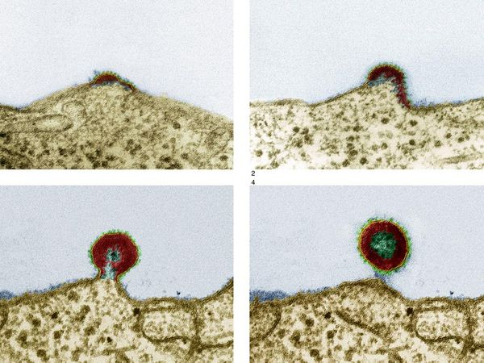
Alcohol’s Effect on HIV
Virus Growth
Alcohol has numerous effects, both direct and indirect, on how the HIV virus develops and how quickly it causes disease.
Alcohol can increase how fast the virus replicates, leading to higher amounts of virus (i.e., the viral load) in the body.
  Those high concentrations, in turn, can increase the spread of the disease.
  In one study, women receiving antiretroviral therapy (ART) who drank moderately or heavily were more likely to have higher levels of the HIV virus, making it easier for them to spread the virus to others.
SOURCE: NIAAA. (2010). Alcohol Alert, Number 80.
63
Notes:
HIV-positive people who drink heavily and who are not on anti-HIV drugs tend to have lower CD4 counts (a measure of immune system function) than moderate drinkers. While the same difference in CD4 count isn’t true for heavy drinkers who are taking anti-HIV drugs, they are more likely to miss doses of their treatment than those who abstain from drinking alcohol.
Providers can examine a youth’s adherence to HAART within the context of: HIV stigma, disclosure, caregiver stress, peer relations, mental health and/or substance use disorder co-occurrence, length of time on HIV medications.
REFERENCE
Reisner, S.L., Mimiaga, M.J., Skeer, M., Perkovich, B., Johnson, C.V., & Safren, S.A. (2009). A review of HIV antiretroviral adherence and intervention studies among HIV-infected youth. Topics in HIV Medicine, 17(1), 14-25.
Photo credit: National Geographic AIDS Photo Gallery, http://science.nationalgeographic.com/science/photos/aids/.

Slide 64
The Importance of Monitoring Alcohol Use Among HIV-Positive Individuals
Even intermittent use can complicate the clinical management of HIV-infected patients by:
  Diminishing adherence to medications
  Increasing risk of liver injury
  Reducing the patient’s ability to practice safer sex
  Increasing the risk of side effects from medications
  Changing pharmacokinetics of prescribed drugs
SOURCE: NIAAA. (2010). Alcohol Alert, Number 80.
64
Notes:
Clinicians may often miss alcohol problems in patients with clinically stable HIV infection and those without evidence of liver disease, which underscores the importance of screening all patients for alcohol use. The role of the primary care clinician in the management of the patient who abuses alcohol or is dependent on alcohol is as follows: (1) identify the problem; (2) present the diagnosis; (3) work to engage and motivate the patient; and (4) participate in the initiation of treatment and continuum of care.

Slide 65
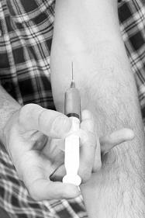
Special Considerations for Young Injection Drug Users (IDUs)
65
Notes:
TRANSITION SLIDE
This next portion of the presentation provides an overview of the special considerations for young injection drug users (IDUs), and the link between injection drug use and HIV risk behavior.

Slide 66
Factors that May Influence Young Drug Users’ Transition to Injection
Curiosity
More pleasure (tolerance development)
“Better trip”, stronger effect, and a quicker onset of the effect
  This is especially relevant when tolerance to a drug begins to develop and the effects are no longer as strong
Financial considerations
Visibility
66
SOURCE: UNODC. (2004). HIV Prevention among Young Injection Drug Users.
Notes:
Some of the factors that influence the transition to IDU are: More pleasure (tolerance development): Injecting the drug provides a “better trip”, a stronger effect, and a quicker onset of the effect. This is especially relevant when tolerance to the drug begins to develop and the effects are no longer as strong. Many heroin users, for example, start by smoking or chasing and report initially being repulsed at the thought of using needles. However, as their tolerance to the drug increased young people found that they were unable to support their use (smoking heroin is inefficient and yields a considerably lower recovery rate than when injected). Curiosity about the effects of injecting, including the “rush” also appears to influence some young people to start injecting. With regards to financial considerations, injecting is more efficient, and it is cheaper than other forms since one can get more pleasure with a smaller dose. Lastly, with regards to visibility, injecting is less visible as it is faster than smoking and does not leave a detectable or distinct smell.
Photo credit: Join Together Online, February 12, 2014.

Slide 67
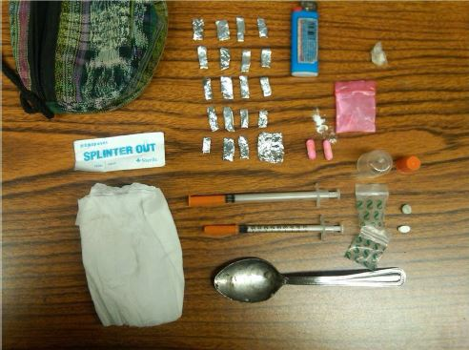
Injection Drug Use among Young People has Increased in the U.S.
Young people who inject drugs
face high levels of risk for HIV,
HCV, other STDs, and drug
overdose
It is important to monitor the
prevalence of IDU among young opioid users
Recent increases in non-medical use of prescription opioids may lead new non-injecting opioid users to start injecting prescription opioids or transition to heroin or stimulant injection
67
SOURCE: Center for Drug Use and HIV Research (CDUHR) Fact Sheet, 2013.
Notes:
Increases in the number of young people who inject drugs are likely to lead to increased numbers of overdose deaths and HIV/AIDS, hepatitis C, and sexually transmitted infections. Recent increases in non-medical use of prescription opioids may lead new non-injecting opioid users to inject prescription opioids or transition to heroin or methamphetamine injecting. By monitoring the prevalence of injection drug use among youth (e.g., how many young people in the population inject drugs) can help to understand the number of youth at risk for poor health outcomes.
Additional Information for the Trainer(s)
The Overdose Treatment Act became law in California on January 1, 2014. The law allows laypeople to possess and administer naloxone to someone in urgent need who is experiencing life threatening respiratory depression from excessive opioid use. Naloxone is a non-scheduled, non-addictive, safe, and inexpensive prescription medication that is available as a nasal spray and auto-injector.
Photo credit: The Fly Effect, May 2014.

Slide 68
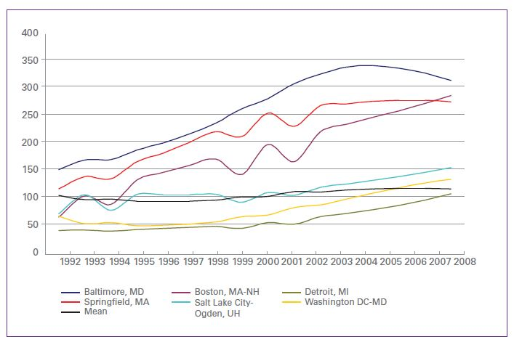
Estimated Prevalence of Youth who Inject Drugs in 6 Large U.S. MSAs and the Mean across 95 Large MSAs (1992- 2007)
68
SOURCE: Center for Drug Use and HIV Research (CDUHR) Fact Sheet, 2013.
Notes:
An NDRI-based research team conducted a study in which they hypothesized that injection drug use among young people would increase after the development of ART due to one or both of the following reasons: (1) Young IDUs would perceive HIV as less of a threat now that there was effective treatment; or (2) Young people would increasingly not have gone through the horrors that some communities of people who injected drugs (and their families and neighbors) went through during the early days of the AIDS epidemic. The research team conducted two studies to determine changes in the estimated number of young people who inject drugs aged 15-29 years from 1992-2007 in 95 metropolitan statistical areas (MSAs) of the United States. They used several data series to estimate the population prevalence of young people who inject drugs in MSAs. Multi-step approaches similar to those used in previous studies were employed to allocate the prevalence of young people who inject drugs in each MSA and to reduce biases in the data.
The number of young people who inject drugs (aged 15-29) declined between 1992 and 1995 and then increased from 1996 (mean = 96 per 10,000 youth) to 2002 (mean = 116 per 10,000 youth). The number of young people who inject drugs continued to increase through 2006-2007 (mean=>120 per 10,000 youth). The more young people who inject drugs in a population in a given year, the more drug-related deaths and accidental and unintentional poisoning deaths there were that year. This provides support for the notion that young people who inject drugs are at high risk for these poor outcomes including death.
REFERENCES
(1) Chatterjee S, Tempalski B, Pouget ER, Cooper HL, Cleland CM, & Friedman SR (2011). Changes in the prevalence of injection
drug use among adolescents and young adults in large U.S. metropolitan areas. AIDS and Behavior, 15, 1570-1578.
(2) Tempalski, B, Pouget, ER, Cleland, CM, Brady, JE, Cooper, HLF, Hall, HI, Lansky, A, West, BS, Friedman, SR (2013). Trends in
the population prevalence of people who inject drugs in US Metropolitan Areas 1992-2007. PLOS ONE , 8(6), e64789.

Slide 69
Injection Drug Use and Sexual Behavior
Drug injectors are at risk of becoming infected with HIV virus and spreading the infection to their sex partners through unsafe sex.
Injecting drug users can act as a bridge to transmit HIV to non-injectors with whom they have sexual contact.
IDUs tend to underestimate the importance of condom use in sexual intercourse and have very low levels of condom use.
69
SOURCE: UNODC. (2004). HIV Prevention among Young Injection Drug Users.; Arasteh & Des Jarlais, 2009.
Notes:
In addition to sexual contact between drug injectors and non-injectors, drug injecting may also contribute to an increased incidence of HIV infection through HIV transmission to the children of drug injecting mothers (this is called “vertical transmission”). HIV is also a risk among drug abusers who do not inject drugs through high-risk sexual behavior. The impact of many types of psychoactive substances, whether injected or not, including alcohol, are risky to the extent that they are disinhibitors and affect the individual’s ability to make decisions about safe sexual behavior.
Additional Information for the Trainer(s)
In a study by Arasteh and Des Jarlais (2009), at-risk drinking among cocaine injectors was associated with distributive sharing of needles/syringes. At-risk drinkers were also more likely to engage in unprotected sex with a casual partner. Finally, among cocaine injectors alcohol intoxication during the most recent sex episode was associated with unprotected sex with a casual partner. These observations indicate that among HIV-positive IDUs at-risk drinking is associated with higher rates of injection and sexual risk behaviors and that alcohol intoxication is related to unprotected sex.
REFERENCE
Arasteh, K., & Des Jarlais, D.C. (2009). At-risk drinking and injection and sexual risk behaviors of HIV-positive injection drug users entering drug treatment in New York City. AIDS Patient Care and STDs, 23(8), 657-661.

Slide 70
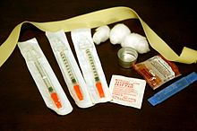
Injection-Related HIV
Risk Behavior
Direct sharing/repeated use of
needles and syringes for
injecting
Indirect sharing/sharing of the
paraphernalia used for drug injection
  Sharing or using unclean water, cookers or cotton
  Stirring drug solution with used syringe plungers
  Squirting the drug solution from a previously blood-contaminated syringe into the drug
70
SOURCE: UNODC. (2004). HIV Prevention among Young Injection Drug Users.
Notes:
Young people share injection equipment more often than older drug users and that they perceive less risk in doing so. The risk of HIV transmission occurs through a variety of direct and indirect sharing activities. Risky injecting episodes usually took place within specific contexts, such as late at night or early morning with no access to sterile syringes, when people were ‘hanging out’ or withdrawing from drugs, or during periods of intoxication or binging.
Additional Information for the Trainer(s)
Backloading: The drug solution is transferred from one previously blood-contaminated syringe to another. The plunger is removed from the syringe into which the drug will be transferred and the drug mixture is then squirted into the back of the syringe.
Frontloading: The drug solution is transferred from one previously blood-contaminated syringe to another by removing the needle on the syringe receiving the solution, and then squirting the drug into the syringe’s hub or barrel. This is now relatively uncommon, since most insulin syringes used by IDUs do not have removable needles.
Photo credit: Wikipedia, March 5, 2014.

Slide 71

Racial/Ethnic Disparities in HIV Rates among IDUs
Globally
Racial/ethnic minority IDUs are twice as likely to be HIV seropositive than majority group IDUs from the same country
Disparities are particularly high in the U.S. and China
Addressing racial/ethnic disparities in HIV infection among IDUs is a fundamental issue in the fight against HIV, particularly in the context of growing emphasis on policies based on scientific evidence and human rights
71
SOURCE: Des Jarlais et al., 2012.
Notes:
An estimated 16 million people across the globe inject drugs, and nearly 20% of these (approximately 3 million individuals) are infected with HIV.
In many locations, high proportions of injection drug users belong to racial and ethnic minority groups, and these individuals appear to experience an increased likelihood of HIV infection compared to the racial/ethnic majority. Higher rates of HIV infection among minorities may have a number of negative implications for controlling the HIV epidemic among IDUs, including multiple reinforcing sources of stigmatization based on racial/ethnic minority status, injecting drug use, and HIV/AIDS, and reluctance on the part of IDU to utilize existing services for fear of stigmatization. Despite these concerns, little is known about racial/ethnic disparities in HIV prevalence among IDUs, which limits the ability to make recommendations to reduce such disparities.
REFERENCE
Des Jarlais DC, Cooper H, Bramson H, Deren S, Hatzakis A, Hagan H (2012). Racial and ethnic disparities and implications for the prevention of HIV among persons who inject drugs. Current Opinion in HIV and AIDS, 7(4), 354-361.

Slide 72
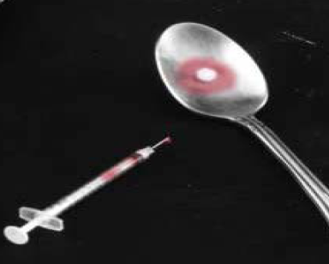
The Specific Issues of Young Injection Drug Users
Young IDUs are not the same as their older counterparts
  Peer influence
  Limited awareness
  Limited access to services
  Perceived lack of
  confidentiality at services
  Economic instability
72
SOURCE: UNODC. (2004). HIV Prevention among Young Injection Drug Users.
Notes:
Peer influence: Youth are curious and can be easily influenced by peer pressure. They often use or abuse drugs within their peer groups and are often guided by the peer norm, where drugs may be considered normal.
Limited awareness: Young IDUs often have limited education, awareness and knowledge of the HIV virus. Information and communication material that may be available is often not written for young people. They may know little about the drugs, their effects, the risks associated with drug abuse, especially drug injection, safer injecting practices and reducing their risk behavior. Risks to health may be regarded as distant or remote as young IDUs do not experience the complexity and severity of health problems as often as they may be encountered by older IDUs who have injected for longer (abscesses, gangrene . . .). It may be difficult for young IDUs to understand the need for prevention efforts when they have not experienced health problems as a result of their own injection drug use.
Limited access to services: Services are often perceived by youth as unfriendly to young people. Young IDUs are often unaware of the existence of health, social, legal and welfare services that could be of help to them. They may not know how to access these services.
Lack of confidentiality at services: Young people, as well as adults in this case, may feel ashamed, fear stigmatization or the lack of privacy and confidentiality when considering approaching treatment services. They may be afraid to make their problem visible, and thus avoid using services.
Economic instability: While adult IDUs usually have an income (at least initially), youth often suffer from economic instability, as they are unemployed and often unskilled after dropping out of school. Many youths have to resort to crime or commercial sex work to get money for drugs.
Additional Information for the Trainer(s)
In light of the UNODC findings presented on this slide, it is important to highlight the results of a National Institute on Drug Abuse-sponsored randomized clinical trial that showed, with respect to opioid dependence, young adults are more like their adult counterparts than we have been comfortable thinking they were. The findings of the NIDA Clinical Trials Network Study conducted by Dr. George Woody and colleagues indicate that longer-term treatment with buprenorphine-naloxone may be more effective for young adults than short-term term detoxification (short-term detoxification led to near universal relapse to opioid use). When compared to those in the detoxification group, subjects in the 12-week condition showed: (1) fewer opioid positive urines; (2) greater retention in active treatment phase; (3) lowered use of marijuana and cocaine use and injection drug use; (4) effect only during active treatment with buprenorphine. Also, it is important to continue providing supportive counseling during the taper period. With regards to the efficacy of using naltrexone following the buprenorphine taper, it is important to note that: (1) naltrexone is an opioid receptor antagonist; (2) it can only be used after discontinuation of buprenorphine; (3) it blocks the ability of endogenous opioids to stimulate the receptor; and (4) it can assist the patient in remaining drug free as part of a long-term recovery counseling program.
REFERENCES
(1) Fiellin, D. A. (2008). Treatment of adolescent opioid dependence: No quick fix. Journal of the American Medical Association, 300(17), 2057-2059.
(2) Woody, G. E., Poole, S. A. Subramaniam, G., Dugosh, K., Bogenschutz, M., Abbott, P., et al. (2008). Extended vs short-term buprenorphine-naloxone for treatment of opioid-addicted youth: a randomized trial. Journal of the American Medical Association, 300(17), 2003-2011.
Photo Credit: CA DPH, Hep C Presentation, January 2014.

Slide 73
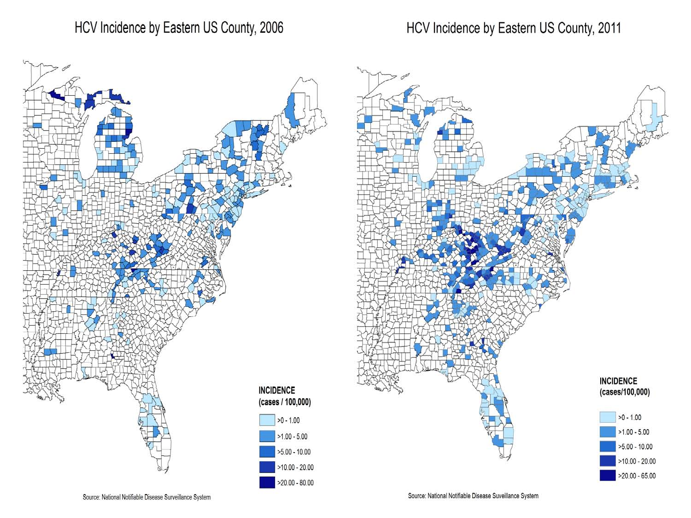
Increasing Reports of Injection-Related HCV Infection among Persons under Age 30
Recent increases seen in at least
18 states
Clustered
specifically
among young IDUs
73
SOURCE: Dan Church. (2014). Hepatitis C Infection in Adolescents and Young Adults: The Second Wave Epidemic.
Notes:
Several states have reported an increase in Hepatitis C cases among individuals under age 30, and in many states, the cases are clustered specifically among young injection drug users. The incidence maps on the right side of the slide are from the National Notifiable Disease Surveillance System. Possible reasons for this increase include: a quadrupling of oral prescription opioid sales between 2000 and 2010; increased access to heroin with injection as preferred route of administration; variability in drug use patterns between jurisdictions (urban vs. suburban vs. rural); and a reduced focus on prevention of blood borne diseases among IDU nationally.
REFERENCE
Church, D. (2014). Hepatitis C Infection in Adolescents and Young Adults: The Second Wave Epidemic. Presentation available at: http://www.cdph.ca.gov/programs/Documents/HepCinYouth01-29-14.pdf.

Slide 74

Assessment and
Intervention Strategies
74
Notes:
TRANSITION SLIDE
Much of what we know about clinical approaches comes from treatment effectiveness studies. These studies tell us about the effectiveness of different treatment models for adolescents with substance use disorders. They include studies with programs deemed “evidence-based.” Evidence-based programs have proven to be successful through research methodology and have produced a consistent pattern of positive results.

Slide 75
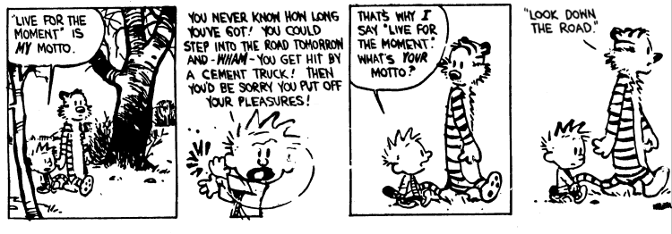
The Clinical Situation is Difficult because Clinical Risk Differs
75
Notes:
INSTRUCTIONS
Read the Calvin and Hobbs cartoon aloud to the audience and elicit their reactions as to the relevance of the cartoon to the issue of adolescent substance use and abuse.

Slide 76
Marijuana and alcohol are gateway drugs that initiate the trajectory toward use of harder drugs.
Strongly Disagree
Disagree
Neutral
Agree
Strongly Agree
76
Notes:
INSTRUCTIONS
Read the question and choices, and review audience responses out loud.
No empirical data exists to support the gateway drug theory. If you take available data and control for access, the gateway phenomenon goes away. Individuals young and old will use substances that (1) make them feel good, or (2) make them feel better (in other words, they use what works for them). Sometimes, people experiment with drugs to have fun; others experiment to cope with issues they are facing with school, family, or friends. If alcohol and marijuana don’t work, they will keep looking for other avenues (e.g., drugs) until they find something that works better. Clinicians need to pay attention to any substance among youth so that initial experimentation does not evolve to issues of abuse and dependence.

Slide 77
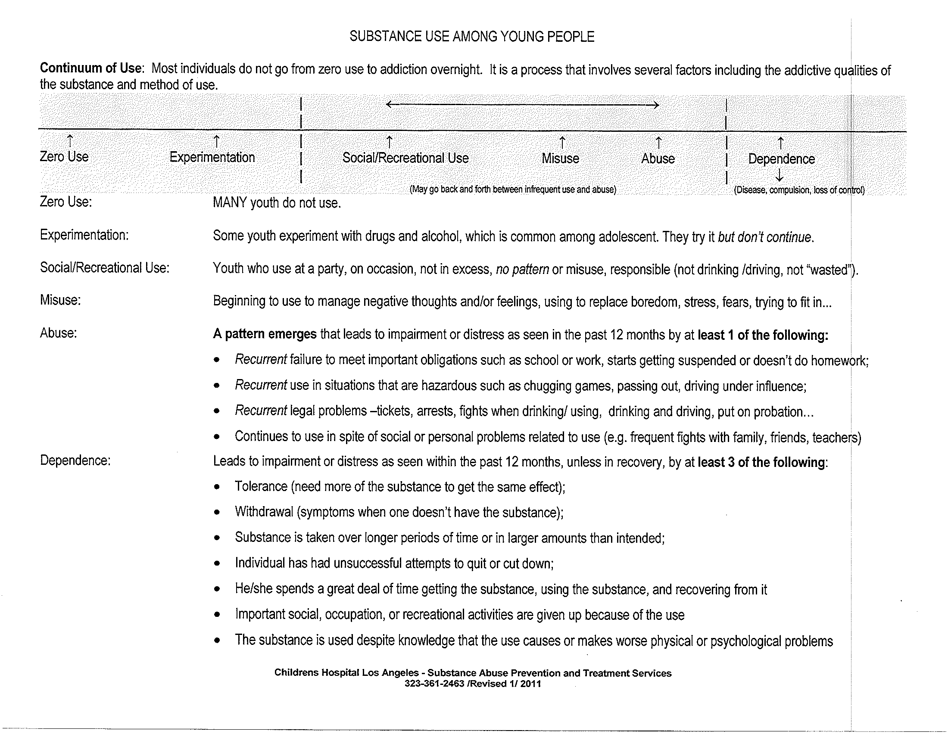
Continuum of Adolescent Substance Use
77
Notes:
Substance use disorders develop along a trajectory, from experimentation and social/recreational use to misuse, abuse, and dependence. This table characterizes each level of use along the continuum.
Additional Information for the Trainer(s)
In the United States, the Diagnostic and Statistical Manual of Mental Disorders (DSM) serves as a universal authority for psychiatric diagnosis. Treatment recommendations, as well as payment by health care providers, are often determined by DSM classifications. When the DSM-5 was released by the American Psychiatric Association in May 2013, it marked the end of more than a decade’s journey in revising the criteria for the diagnosis and classification of mental disorders. The DSM-5 discusses substance use disorders as a continuum disorder (mild-moderate-severe), which is more accurate than previous versions of the DSM in describing substance use disorders. The severity of the SUD is based on the number of criteria/symptoms endorsed.

Slide 78
Clinical Risk and System Response
Clinical Trajectory
Primary Prevention Services
Secondary Prevention
Brief Intervention
Brief Treatment
Traditional Treatment
Brief Intervention=Educational
Pre Use Abstinence
Experimental Use
Social/Recreational
Use
Misuse
Substance Abuse
Substance Dependence
15% of the Population
70% of the Population
15% of the Population
78
SOURCE: SBIRT Project 2007, Stephen O’Neil.
Notes:
If you look at the clinical trajectory of substance use disorders, you see that 70% of the population falls in the middle of the continuum (from experimentation to substance abuse). The remaining 30% of the population either fall in the pre-use/abstinence stage (15%) or substance dependence (15%).
This figure, which is not specific to adolescents and young adults but includes all users, highlights the clinical responses that can be used at each stage of the substance use disorder continuum. For example for those individuals who are experimenting with substances or using substances socially/recreationally, secondary prevention techniques such as a brief intervention is warranted. At the far right end of the continuum are the individual who have been diagnosed with substance dependence. In that stage, traditional substance use disorder treatment (outpatient/residential) is warranted. It is important to note that this schematic is based on the DSM-IV-TR.

Slide 79

Understanding Problem Severity
Screening is essential
  To determine RISK - the actual problem severity– where are
  they along the clinical risk continuum of use?
  Standardized Screeners
    CRAFFT (available in English and Spanish)
79
SOURCE: Knight et al., 2002.
Notes:
Routine alcohol and drug screening provides clinicians with the opportunity to query all clients/patients about their substance use to determine if they are using at risky levels.
By utilizing a standardized screening instrument, clinicians do not have to make a “judgment call” to subjectively determine who might actually be at risk for developing a
substance use disorder. Adolescents are highly responsive to judgment and criticism, so it is best to approach the topic of substance use in an objective manner. Several validated
screeners are available for free in the public domain, and include the CRAFFT, AUDIT, DAST, and ASSIST.
It is important to note that any alcohol or drug use among individuals under the age of 21 is considered risky (and illegal), because the legal drinking age is 21.
REFERENCES
(1) CRAFFT: http://www.ceasar-boston.org/clinicians/crafft.php
(2) AUDIT: http://whqlibdoc.who.int/hq/2001/who_msd_msb_01.6a.pdf
(3) ASSIST: http://www.who.int/substance_abuse/activities/assist/en/
(4) DAST: http://www.smchealth.org/sites/default/files/docs/1309587937DRUGUSEQUESTIONNAIRE.pdf
(5) Knight, JR, Sherritt, LA, et al. (2002). Validity of the CRAFFT substance abuse screening test among adolescent clinic patients. Archives of Pediatric and Adolescent Medicine, 156(6), 607-614.

Slide 80

Substance Use Screening Activity
✓
80
Notes:
The next three slides correspond to a quick group activity to help orient training participants to a standardized screening process, and become comfortable asking their patients/clients questions about their alcohol and drug use. The CRAFFT screening tool, developed by a Boston University-based research team, will be used for this activity, and will be described in more detail in the next few slides.
Photo credit: Join Together Online, 2014.

Slide 81
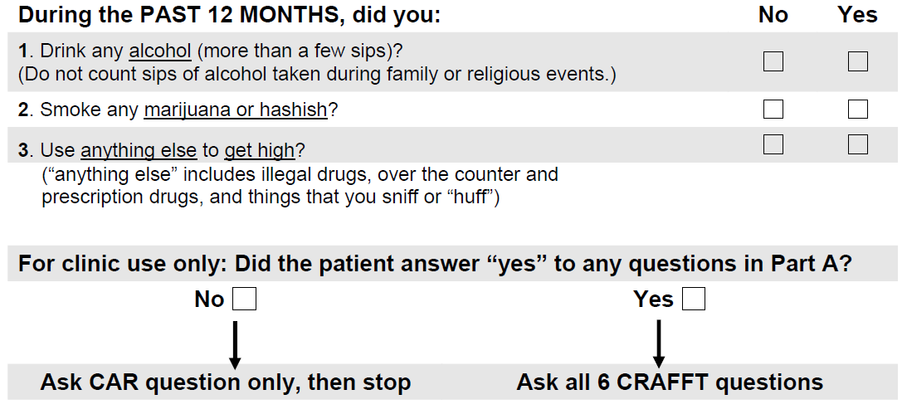
CRAFFT Part A
81
SOURCE: Knight et al., 2002.
Notes:
The CRAFFT is a behavioral health screening tool for use with adolescents and young adults under the age of 21 and is recommended by the American Academy of Pediatrics' Committee on Substance Abuse for use with adolescents. The screener consists of 6 questions developed to screen adolescents for high risk alcohol and other drug use disorders simultaneously. It is short and effective, and is meant to assess whether a longer conversation about the context of use, frequency, and other risks and consequences of alcohol and other drug use is warranted.
Part A of the CRAFFT corresponds to three opening questions about past year alcohol and drug use. If the adolescent answers "No" to all three opening questions, the provider only needs to ask the adolescent the first CRAFFT question - the CAR question. If the adolescent answers "Yes" to any one or more of the three opening questions, the provider asks all six CRAFFT questions. The CAR question is asked of all adolescents, because there is risk associated with just being around alcohol and drugs (as much as using them personally).
REFERENCE
Knight, JR, Sherritt, LA, et al. (2002). Validity of the CRAFFT substance abuse screening test among adolescent clinic patients. Archives of Pediatric and Adolescent Medicine, 156(6), 607-614.

Slide 82
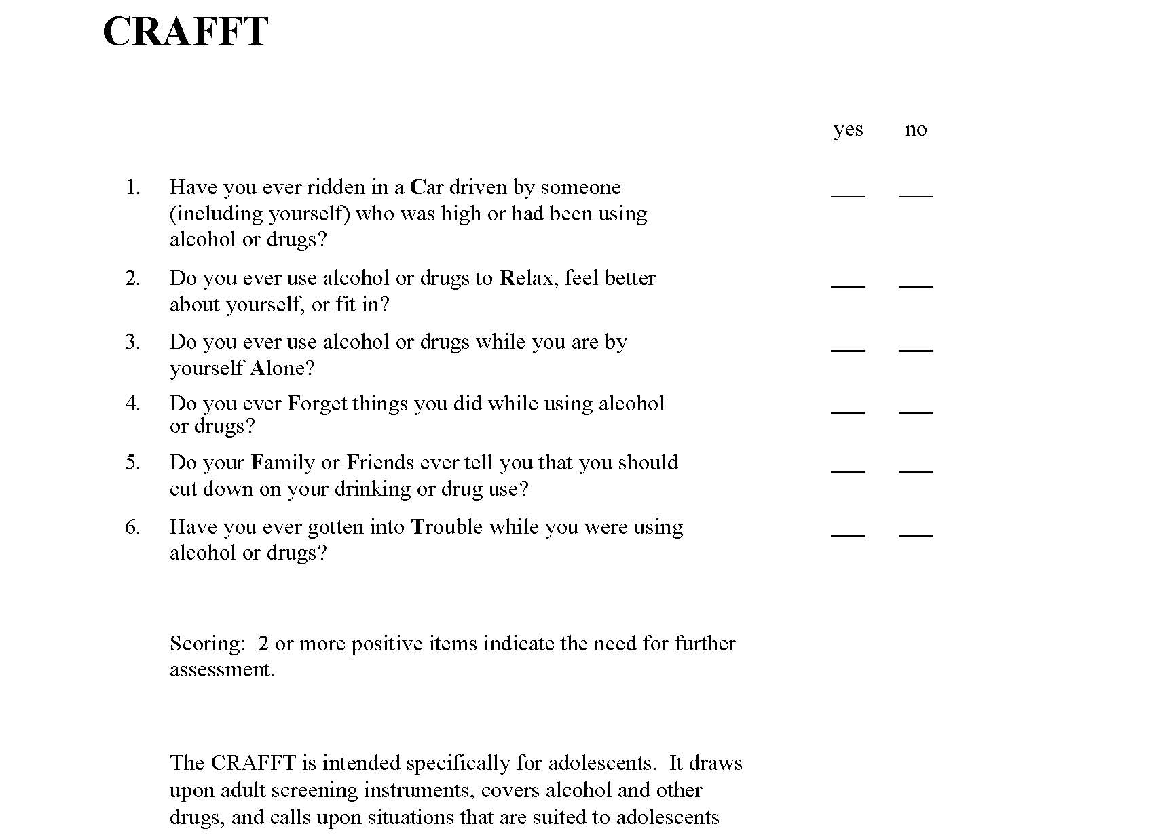
CRAFFT Part B
Responsibility element
Coping element – use moves beyond pleasure
Isolation/Social Withdraw element
Impairment element
Problem Use recognized by others
Consequences of use*
82
SOURCE: Knight et al., 2002.
Notes:
CRAFFT is a mnemonic acronym of first letters of key words in the six screening questions. The questions should be asked exactly as written; the questions are vague and broad, and none should be particularly threatening to adolescents.
C – Have you ever ridden in a CAR driven by someone (including yourself) who was "high" or had been using alcohol or drugs?
R – Do you ever use alcohol or drugs to RELAX, feel better about yourself, or fit in?
A – Do you ever use alcohol/drugs while you are by yourself, ALONE?
F – Do you ever FORGET things you did while using alcohol or drugs?
F – Do your family or FRIENDS ever tell you that you should cut down on your drinking or drug use?
T – Have you gotten into TROUBLE while you were using alcohol or drugs?
A Score of 1: No Evidence of risk
A Score of 2 or more: Positive screen; indicates need for further assessment.
REFERENCE
Knight, JR, Sherritt, LA, et al. (2002). Validity of the CRAFFT substance abuse screening test among adolescent clinic patients. Archives of Pediatric and Adolescent Medicine, 156(6), 607-614.

Slide 83
CRAFFT Practice Session – “Alex”
An 18-year old named Alex presented to the ER with minor injuries sustained in a single-car motor vehicle accident. The ER nurse asked the 3 CRAFFT opening questions. Alex replied that (s)he had used alcohol and marijuana during the past 12 months. The nurse asked the CRAFFT questions and documented that Alex responded “Yes” to 3 of the questions. She then called the covering physician to discuss how to respond to Alex’s CRAFFT total score of 3**.
Scoring**:
1: No Evidence of risk; 2+: Positive screen; indicates need for further assessment.
83
Notes:
INSTRUCTIONS
**Allow 10-15 minutes for this activity**
With regards to introducing the CRAFFT screening process to the adolescent, it is helpful to keep the following recommendations in mind:
It is critical to provide a gentle introduction to talking about substance use—which may be awkward or embarrassing. It is important to tell the adolescent that some questions are personal and that the information is confidential.
Adolescents may be surprised by the desire to ask them questions about substance use, so your job as the interviewer is to normalize this procedure as much as you can. You can do this by being straight-forward about the screening, e.g., “This is part of routine care that we provide.” You want to tell the adolescent that you are asking the questions in order to provide the best possible care.
Also, you want to tell the adolescent that he or she doesn’t have to answer a question if they are uncomfortable.
If a comfortable environment is created for adolescents, most will respond well to the screening and will provide honest answers. Even if the adolescents underestimate their use (or are not completely honest about their substance use), the provider will still have a very good chance of identifying their risk level.
To get acquainted with the questions included on the CRAFFT, participants are asked to break into pairs. One person will play the role of a clinician and the other person will play the adolescent. Refer participants to the blank CRAFFT form in the materials packet. The clinician should introduce the CRAFFT as described above, and then run through the questions of the CRAFFT. For the person playing the clinician, make sure the questions are asked exactly as they are written and read the response options to the adolescent. For those playing the adolescent, make up your own answers; just don’t make them too tricky or hard, and refrain from role playing the most difficult kid ever!
Allow the audience a minute to form pairs and locate the CRAFFT in their materials. Leave this slide up during the run-through so people can refer back to these statements. Give the participants 5 minutes to complete this portion of the activity.
Allow 5-7 minutes for the de-brief portion of the activity. Bring the full group back together, and ask people for their feedback regarding specific items on the CRAFFT. What are their initial reactions to the questions as they are written?
Additional Information for the Trainer(s)
Some people may comment that a question is vague or poorly worded. In response, acknowledge their feedback and reassure them that no instrument is perfect, but the CRAFFT has undergone a tremendous amount of research and has very good reliability and validity. This means that it works well to identify risky substance use, even if some of the questions seem to be poorly worded.

Slide 84
Assessing beyond Problem Severity
Assessment & Diagnosis
  This process helps determine the
  specific issues of the individual –
  beyond substance use (and to guide treatment planning/placement)
    Global Appraisal of Individual
    Needs (GAIN)
    Addiction Severity Index 4 Teens
    (T-ASI)
    Adolescent Problem Severity Index (APSI)
84
Notes:
This slide corresponds specifically to the assessment and diagnosis process. The GAIN, T-ASI, and APSI are all examples of assessment tools that can be utilized with an adolescent population, and are more in-depth than the screeners described on the previous slides. Interested practitioners can look into the proprietary nature of the assessment tools, as well as their length, to determine which is most in line with their needs. The information gathered during the assessment and diagnosis process can be used to guide further conversations with the adolescent, once he/she is engaged in the treatment process.

Slide 85

Complexities for
Clinical Treatment
Majority of adolescents presenting for treatment with more than just substance use problems…
  Psychological co-occurring (trauma, depression, anxiety, etc.) histories
  Delinquent/legal, court/probation issues
  School drop-out/academic failure issues
  Family dysfunction
85
Notes:
It is essential for providers to understand the context of alcohol and drug use among adolescents. Oftentimes, it’s not just substance use, but substance use in the context of other issues and problems (trauma, abuse, relationship issues, etc.). Substance use can either lead to other issues, or substances can be used to mask other primary issues. How you intervene may be different depending on the reasons the adolescent is using alcohol and other drugs. The adolescent’s relationships with his/her family is a critical area to explore in more detail, as is problems/difficulties with school and criminal justice involvement (intervene with the whole person and not just a single issue).

Slide 86
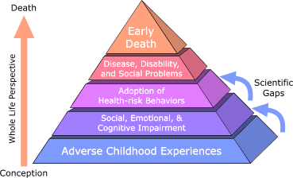
Adverse Childhood Experiences Study (ACE)
Ongoing collaborative research between the CDC and Kaiser Permanente
Over 17,000 Kaiser patients participating in routine health screening volunteered to participate in the study
Data reveal staggering
proof of the health,
social, and economic
risks that result from childhood trauma
86
SOURCE: The ACE Study, http://acestudy.org.
Notes:
The ACE Study is ongoing collaborative research between the Centers for Disease Control and Prevention in Atlanta, GA, and Kaiser Permanente in San Diego, CA and represents one of the largest investigations ever conducted to assess associations between childhood maltreatment and later-life health and well-being. The Co-Principal Investigators of the study are Robert F. Anda, MD, MS, with the CDC; and Vincent J. Felitti, MD, with Kaiser Permanente. Over 17,000 Kaiser patients participating in routine health screening volunteered to participate in the study. Data resulting from their participation continues to be analyzed; it reveals staggering proof of the health, social, and economic risks that result from childhood trauma. The CDC provides access to the peer-reviewed publications resulting from The ACE Study (http://www.cdc.gov/violenceprevention/acestudy/). To date, more than 50 scientific articles have been published and more than100 conference and workshop presentations have been made.
The ACE Study findings suggest that certain experiences are major risk factors for the leading causes of illness and death as well as poor quality of life in the United States. It is critical to understand how some of the worst health and social problems in our nation can arise as a consequence of adverse childhood experiences. Realizing these connections is likely to improve efforts towards prevention and recovery.
Additional Information for the Trainer(s)
The ACE Pyramid (pictured on slide 56) represents the conceptual framework for the study. During the time period of the 1980s and early 1990s, information about risk factors for disease had been widely researched and merged into public education and prevention programs. It was also clear, however, that risk factors, such as smoking, alcohol abuse, and sexual behaviors for many common diseases were not randomly distributed in the population. In fact, it was known that risk factors for many chronic diseases tended to cluster, that is, persons who had one risk factor tended to have one or more other risk factors too. Because of this knowledge, the ACE Study was designed to assess what we considered to be “scientific gaps” about the origins of risk factors. These gaps are depicted as the two arrows linking Adverse Childhood Experiences to risk factors that lead to the health and social consequences higher up the pyramid. Specifically, the study was designed to provide data that would help answer the question: “If risk factors for disease, disability, and early mortality are not randomly distributed, what influences precede the adoption or development of them?” By providing information to answer this question, we hoped to provide scientific information that would be useful for developing new and more effective prevention programs. The ACE Study takes a whole life perspective, as indicated on the orange arrow leading from conception to death. By working within this framework, the ACE Study began to progressively uncover how adverse childhood experiences (ACE) are strongly related to development and prevalence of risk factors for disease and health and social well-being throughout the lifespan.

Slide 87
Major Findings of the ACE Study
ACEs such as childhood abuse, neglect, and exposure to other traumatic stressors are common
Almost two-thirds of the ACE Study participants reported at least one ACE, and more than one of five reported three or more ACE
The short- and long-term outcomes of these childhood exposures include a multitude of health and social problems
87
SOURCE: The ACE Study, http://acestudy.org.
Notes:
Childhood abuse, neglect, and exposure to other traumatic stressors which are termed adverse childhood experiences (ACE) are common. Almost two-thirds of our study participants reported at least one ACE, and more than one of five reported three or more ACE. The short- and long-term outcomes of these childhood exposures include a multitude of health and social problems.

Slide 88
The ACE Score – Risk for Health Problems
Alcoholism and alcohol abuse
Chronic obstructive pulmonary disease (COPD)
Depression
Fetal death
Health-related quality of life
Illicit drug use
Ischemic heart disease (IHD)
Liver disease
Risk for intimate partner violence
Multiple sexual partners
Sexually transmitted diseases (STDs)
Smoking
Suicide attempts
Unintended pregnancies
Early initiation of smoking
Early initiation of sexual activity
Adolescent pregnancy
88
SOURCE: The ACE Study, http://acestudy.org.
Notes:
The ACE Study uses the ACE Score, which is a total count of the number of ACEs reported by respondents. The ACE Score is used to assess the total amount of stress during childhood and has demonstrated that as the number of ACE increase, the risk for the health problems featured on the slide increases in a strong and graded fashion.
A wealth of information related to the ACE Study is available at: http://www.cdc.gov/violenceprevention/acestudy/.

Slide 89
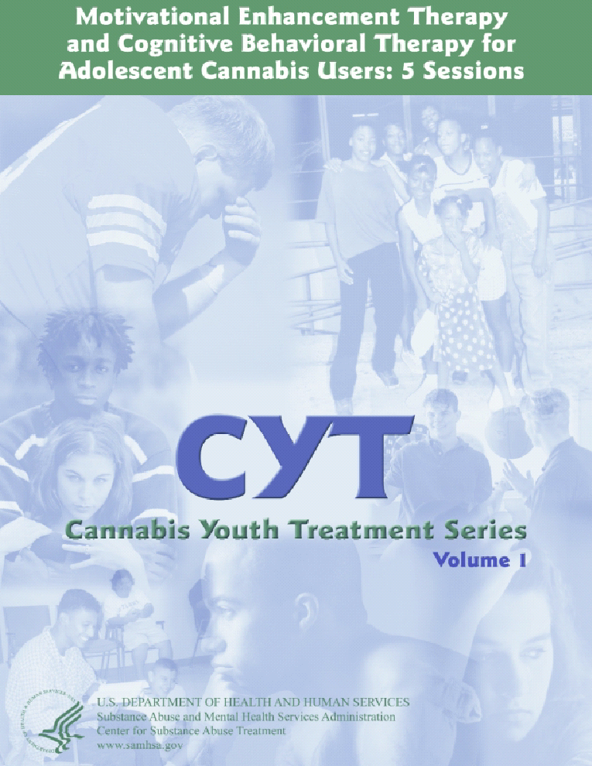
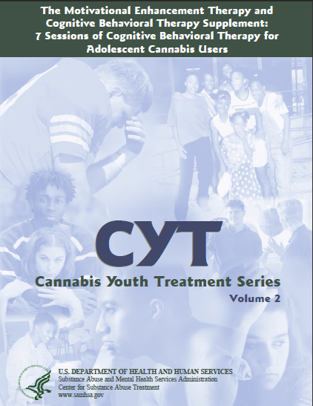
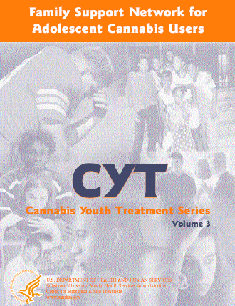
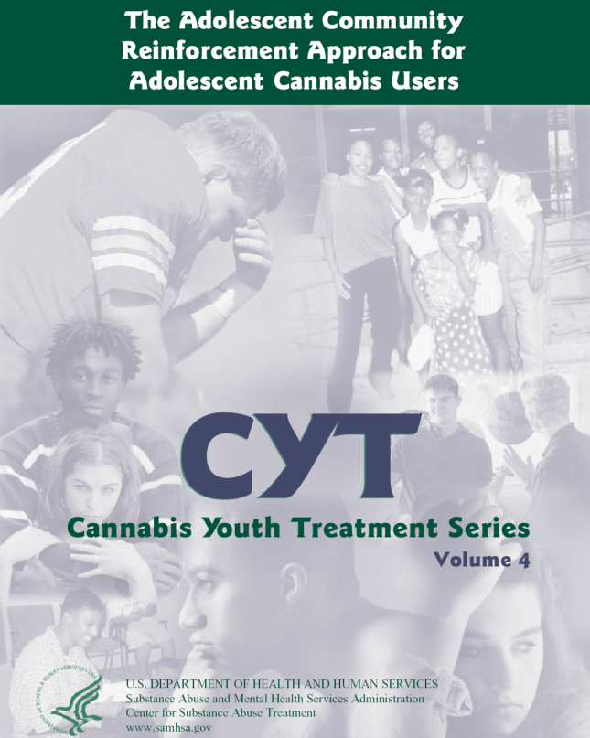
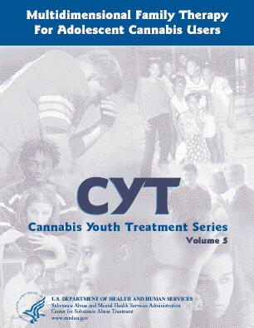
Cannabis Youth Treatment Series
SOURCE: Treatment manuals available from National Clearinghouse for Alcohol and Drug Information (NCADI) or www.chestnut.org/li.
89
Notes:
The Cannabis Youth Treatment (CYT) was designed to adapt five promising adolescent treatments for use in clinical practice, and then to field test their effectiveness in the largest randomized experiment ever conducted with adolescent marijuana users seeking outpatient treatment. These treatments vary in terms of length (6 to 14 weeks), mode (individual, group, and family), planned number of sessions (5 to 23), theoretical orientation, and their approach to resource utilization/cost. All approaches have been recommended by expert panels and/or by earlier reviews of treatment research.
The studies aim to (1) test the relative effectiveness and cost-effectiveness of a variety of interventions which are targeted at reducing/eliminating marijuana use and its associated problems in adolescents, and (2) provide validated models of these interventions for the treatment field. The study was funded by the Center for Substance Abuse Treatment, and has been conducted by Chestnut Health Systems (CHS-MC) in Bloomington and Madison County, IL, Alcohol Research Center (ARC) in Farmington, CT, Operation PAR in St. Petersburg, FL, and the Child Guidance Center (CGC) in Philadelphia, PA.
Preliminary results suggested that all five of the CYT treatments were more effective than current practice, so CSAT released the manuals to the field in 2000. Four of the five components are described in separate entries in the EBP database; component 4 (ACRA) is not yet listed separately pending publication of research results, however, the manual is available.
MET/CBT5 - This is a five-session treatment composed of two individual sessions of Motivational Enhancement Therapy (MET) and three weekly group sessions of Cognitive-Behavioral Therapy (CBT). The MET sessions focus on factors that motivate participants who abuse substances to change, while in the CBT sessions, participants learn skills to cope with problems and meet needs in ways that do not involve turning to marijuana or alcohol. This treatment is designed to be inexpensive and in line with what many parents and insurers are seeking as a basic intervention. (See also separate entry for MET/CBT.)
MET/CBT12 - This treatment is composed of two sessions of MET and ten weekly group sessions of CBT. This treatment is designed to provide more of the same kind of treatment as MET/CBT5 to test for dosage effects and is more in line with what many providers try to provide. (See also separate entry for MET/CBT.)
FSN - The Family Support Network (FSN) treatment includes the MET/CBT12 group therapy plus additional engagement-type case management, family support groups, and aftercare. This treatment was designed to wrap several additional low-cost services around the MET/CBT12 group therapy. This treatment is designed to try and address family issues and services in line with CSAT TIPS recommendations. (See also separate entry for FSN)
ACRA - The Adolescent Community Reinforcement Approach (ACRA) is composed of ten individual sessions with the adolescent and four sessions with caregivers. The focus is on rearranging environmental contingencies so that abstinence from marijuana is more rewarding than using behavior. ACRA will teach participants how to build on their reinforcers, how to use existing community resources that will support positive change, and how to develop a positive support system within the family.
MDFT - Multidimensional Family Therapy (MDFT) is a twelve-week, is composed of 12 to 15 individual family-focused sessions plus additional phone and case management contacts. Sessions are with the participant and his/her family on an individual basis with more focus on roles, other problem areas and their interaction. This treatment tries to use a more integrated approach to family issues and focuses on helping adolescents build more effective and age-appropriate interpersonal and conflict resolution skills while helping parents establish a more effective and supportive parenting style. Treatment also focuses on building appropriate social supports with peers, schools and other involved services providers. (See also separate entry for MDFT.)
These five treatments can also be grouped in several different ways. First, they vary by mode - with the first three being combinations of individual and group approaches and the last two being purely individual treatment approaches. Second, the MET/CBT and ACRA interventions are based on behavioral treatment approaches while the FSN and MDFT interventions are based on family treatment approaches. Third, they are expected to vary in terms of increasing resource intensity and cost.
Outcomes at one-year indicated that though the CYT treatments were more effective than many earlier outpatient treatments, over 2/3rds of the CYT adolescents were still having problems 12 months later. In general, the interventions were successful and affordable in a wide range of settings, and the initial costs of treatment were quickly offset by reductions in other costs to society.
REFERENCES
Volume 1: Motivational Enhance Treatment/Cognitive Behavior Therapy (MET/CBT5)
Sampl, S., & Kadden, R. (2001). University of Connecticut Health Center, Farmington, CT USA.
Available for download at: http://store.samhsa.gov/shin/content//SMA05-4010/SMA05-4010.pdf.
Volume 2: Cognitive Behavior Therapy 7 (CBT7)
Webb, C., Scudder, M., Kaminer, Y., Kadden, R., & Tawfik, Z. (2002). University of Connecticut Health Center, Farmington, CT USA.
Available for download at: http://store.samhsa.gov/shin/content//SMA08-3954/SMA08-3954.pdf.
Volume 3: Family Support Network (FSN)
Hamilton, N., Brantley, L., Tims, F., Angelovich, N., & McDougall, B. (2001). Operation PAR, St. Petersburg, FL USA.
Available for download at: http://store.samhsa.gov/shin/content//SMA05-4103/SMA05-4103.pdf.
Volume 4: Adolescent Community Reinforcement Approach (ACRA)
Godley, S.H., Meyers*, R.J., Smith*, J.E., Godley, M.D., Titus, J.M., Karvinen, T., Dent, G., Passetti, L., & Kelberg, P. (2001). Chestnut Health Systems, Bloomington, IL USA, and *University of New Mexico, Albuquerque, NM USA.
Available for download at: http://store.samhsa.gov/shin/content//SMA08-3864/SMA08-3864.pdf.
Volume 5: Multidimensional Family Therapy (MDFT)
Liddle, H.A. (2002). University of Miami, Miami, FL USA.
(Manual not available online)

Slide 90
“The Chase”
SUD
Nagging Parents
Family
Physical Problem
Housing
SUD
Mental Health
90
Notes:
**ANIMATION**
It is critical that providers meet the young person where they are at; in other words, focus on his/her presenting problem. If you focus on what you think the adolescent needs help with, you end up in a “chase,” where you focus on what you, as the expert, think the issue is, and not what young person is willing to discuss. To provide an example, if you think the adolescent’s adolescent use is the primary issue, but he wants to talk about his nagging parents, you could say, “how important is it for you to get your mom off your back?” By asking this question, you can get him to talk about his relationship with his mom, which will undoubtedly unearth an issue with his marijuana use. So you will get to your issue eventually, but the young man will feel heard because you chose to focus on the one thing (his nagging mom) he was willing to talk about with you.

Slide 91

Where do you Start?
What you do depends on where the adolescent is in the process of changing.
The first step is to determine the adolescent’s current stage of change.
91
Notes:
We have to start by assessing how aware the patient is of his or her substance use and the consequences (e.g., where are they at in terms of their stage of change?).
Click to animate first sentence.
What we do depends on where the patient is in the process of changing. Most of the time patients are coming to us for other concerns and have not thought about changing their substance use.
Click to animate second sentence.
The first step, then, is the identify from where our patients are coming. We want to know how substance use fits into people’s lives so we can understand their situation. In other words, you assess their readiness to change, and meet them where they are currently.

Slide 92
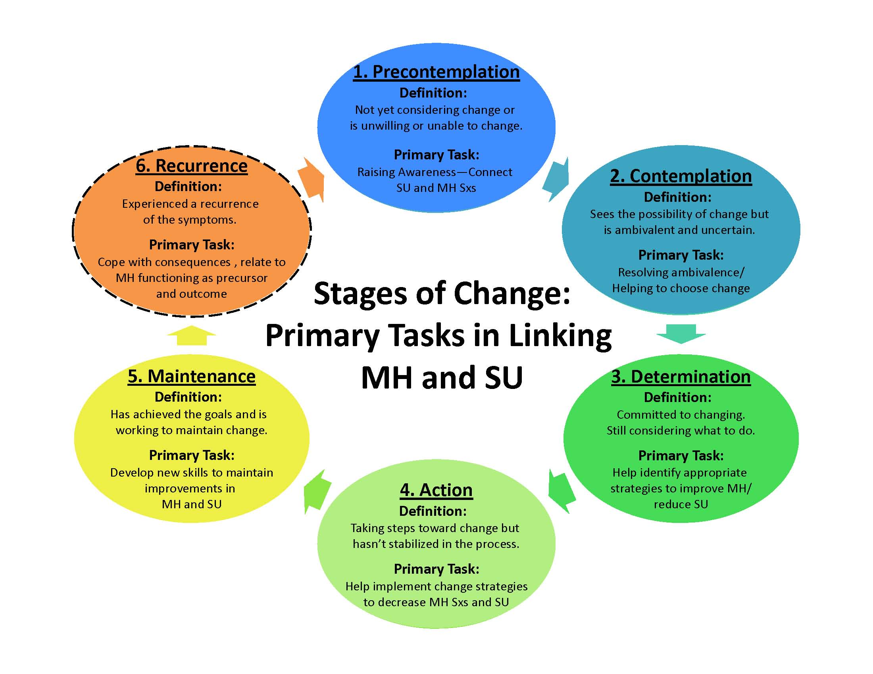
92
Notes:
The Stages of Change is a theoretical perspective introduced by Prochaska and DiClemente more than 20 years ago to help professionals understand their clients with addiction problems and motivate them to change. Their model is based not on abstract theories but on their personal observations of how people went about modifying problem behaviors such as smoking, overeating and problem drinking. The Stages of Change can help clinicians understand where a person is coming from in terms of their substance use. At the top in blue is the first stage called precontemplation. At this stage people do not see a problem with their use and are not considering change.
Use a pointer so participants can follow along on screen.
The stages that follow are contemplation, determination, action, maintenance, and recurrence.
Contemplation is a stage that we strive to move patients to if they are at risk for substance use related problems. Patients in the contemplation stage can see the possibility of change, but they are ambivalent about changing. The determination stage is where we begin to identify strategies for change. Action is where changes are taking place. Maintenance is where patients have achieved their goal and are working to maintain their new behaviors. Recurrence is when patients may relapse or go back to their old behaviors. Recurrence is part of the process of changing.

Slide 93
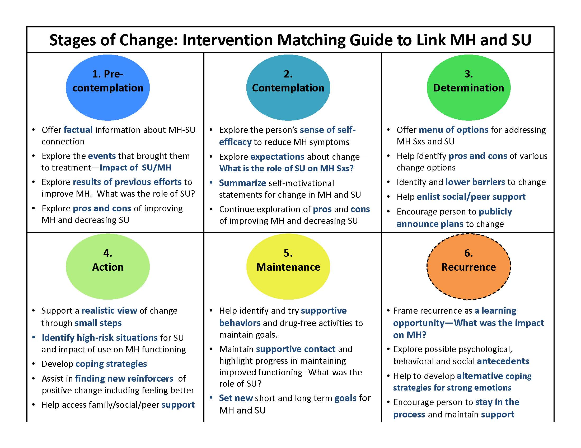
93
Notes:
This chart shows what strategies we can employ with patients at the different stages of readiness to change. If we look at the first two stages—which are most relevant for people engaging in at-risk levels of substance use—we can see that our goals are just to offer information or feedback, explore the meaning of events, explore pros and cons of substance use, and build self-efficacy.
Patients may not be ready to make a change at the time of this brief intervention. However, they may be willing to explore the pros and cons of their use, or track levels of use to see if they may have a more significant problem than they realized. By linking the interventions to where they are in the stages of change, we can help to move them forward in the stages and increase the likelihood that they will take action.
If we get ahead of them (ask them to take action before they have identified that they even have a problem), we are likely to stimulate resistance.
93

Slide 94




How you Communicate with an Adolescent Matters
You are singing off key if you find
yourself…
Challenging
Warning
Finger-wagging
Moralizing
Giving
unwanted advice
Shaming
Labeling
Confronting
Being
Sarcastic
Playing
expert
94
Notes:
More motivational approaches to communicating with adolescents and young adults are work better than confrontational ones. The Office of Adolescent Health (U.S. DHHS) recommends a number of strategies that can be utilized by clinicians when communicating with adolescents and young adults:
Nurture a warm relationship: Teens tend to be more willing to accept and make parental values their own when they feel close to their parents. And close families usually have many shared interests and values that reinforce each other. Thus, keeping a strong relationship lies at the foundation of nurturing positive values in your teen.
Show and tell what matters: A key to your influence on teens’ values is that they understand what really matters to you. The best way to make sure teens understand what really matters to you is to both show and tell—help them see the values in action in your own life, then talk about why you do what you do. Getting their attention, being clear, and regularly reinforcing the values all help teens understand the values you hope for them—increasing the likelihood that they will make those values their own.
Promote open communication: Teens are more likely to take on their parents’ values when they have open, frequent, and honest communication with each other—when teens feel comfortable talking with their parents about tough issues and about things that matter to them. Open communication increases the odds that teens will listen to and embrace their parents’ values. In addition, parents gain a greater understanding of how their teens think and what’s important to them. That makes it easier to connect the parents’ values with the teens’ own emerging values.
Pay attention to their world and interests: When you show interest in the things that matter to adolescents, you show them that you care about their choices and activities. That attentiveness, in turn, motivates your teen to pay attention to and accept your values and expectations.
Give your teen choices and appropriate independence: Believing that they have power in their own lives and can influence others can help adolescents develop their own values. If parents don’t give choices or don’t see their teens as unique individuals, young people may end up pushing away in order to develop their own sense of who they are.
Provide information, guidelines, and structures: In addition to giving teens opportunities to make their own choices, it is just as important to set clear and fair expectations and consequences then follow through with the consequences when needed.
Learn from your teen: Your relationship with your teen is a two-way street. You learn from each other. Through their experiences, they may develop values and beliefs that enrich your life and help you see the world and other people in new ways. Be open to what they have to teach you. In the process, they will be open to what you have to teach them.
Make sure your values are in sync with the other parent (when applicable): Shared values between parents increase the likelihood that their teens will accept their value priorities. If values are not shared, teens may feel conflicting loyalties in picking which values to adopt as their own.
Cultivate skills to put values into practice: In order to develop values, teens need skills to help them be confident in standing up for what they believe and to take actions based on their values. Building assertiveness and the ability to resist peer pressure, the ability to understand what it feels like to be in somebody else’s shoes, and the skills of caring and compassion all help to reinforce positive values.
Provide experiences that reinforce positive values and commitments: If caring for others is important, give young people opportunities to care for others. If being honest is important, give them opportunities to be honest. If being generous is important, give them opportunities to share. If being responsible is important, give them responsibilities where others are depending on them. When you do, be sure to talk about or reflect on the experience, so they become more articulate about why they do what they do.
View mistakes as teachable moments: Teens are going to make mistakes sometimes and not live up to your values or their own values. Sometimes these mistakes are fairly trivial; sometimes they have big consequences. In each case, remember to keep your relationship with your teen as a priority, and find ways for both of you to learn from your mistakes. Think together through appropriate consequences as well as other ways to deal with the issue in the future. That may take time, but it can pay off in the long run.
Recognize the limits: Even though you can and do influence your teens’ values, you don’t control them. For better or worse, many factors also influence the values teens develop. That can include media, friends, teachers, coaches, and celebrities. It can also include world events that “print” values and priorities into young people’s consciousness. So your children won’t necessarily see the values you share as being as important as you see them. Indeed, they may choose to reject some values that are really important to you. That doesn’t mean you have failed; it means they are becoming their own persons.

Slide 95
It is important to approach the topic of substance use very delicately because it will likely lead to resistance.
Strongly Disagree
Disagree
Neutral
Agree
Strongly agree
95
Notes:
INSTRUCTIONS
Read the question and choices, and review audience responses out loud.
This is an opinion question, and presents a good opportunity to engage the audience in a very brief discussion on what is meant by resistance. When it comes to resistance, the harder you (as the clinician) push a client, the harder he/she pushes back. You initiate a challenge, and the client responds. They push back for a variety of reasons, including because they feel inferior and want to stand their ground. If you step away or let go, the client no longer has something to push back against (also called rolling with resistance).

Slide 96

Five Strategies of Motivational Enhancement Therapy (MET)
1. Express Empathy
2. Develop Discrepancy
3. Avoid Argumentation
4. Roll with Resistance
5. Support Self-Efficacy
96
SOURCE: SAMHSA-CSAT. (1999). TIP 35: Enhancing Motivation for Change in Substance Abuse Treatment.
Notes:
Motivational Enhancement Therapy (MET) employs a variation of Motivational Interviewing (MI) to analyze and dissect feedback gained from client sessions. MI focuses on re-patterning client behavior that is the result of ambiguous and undefined thoughts. This form of therapy is presented in a direct and client targeted manner that strives to transform undesired behaviors. Motivational Enhancement Therapy was developed by William Miller and Stephen Rollnick. The goal of MET is to aid the client in clarifying his or her own perceptions and beliefs in order to direct him or her in a more decisive way. Most people who respond to this type of treatment have struggled for years in a mire of ambivalence and welcome the opportunity to have vision and focus in their lives.
MET is commonly used for the treatment of addictions, including abuse of alcohol and other substances. MET is administered in a receptive atmosphere that allows a client to receive feedback from the therapist for the purpose of fortifying the client’s resolve for transformation and to empower the client with a feeling of self-control. Rather than engaging the client’s defense mechanisms through confrontational discourse, the therapist works with the client to create positive affirmations and a sense of inner willingness to facilitate change. Once that is achieved, the client becomes receptive to the healing process and progresses toward wellness.
Clients who are faced with the challenge of substance abuse experience similar emotional and mental symptoms to rebellious adolescents, including resistance, narcissism, relational difficulties, and moodiness. MET has been proven to provide substantial relief from these symptoms and has been recognized as a useful tool for gaining control of these unwanted behavior patterns. MET can be applied to clients regardless of their commitment level and the course of treatment is usually brief. It has shown significant efficacy in clients who have previously demonstrated strong resistance to or weak motivation for change. It is particularly helpful to adolescents dealing with similar issues.
With regards to #1, one way to express empathy with adolescent clients is to use skillful reflections. An empathic style communicates respect for and acceptance of the client and his/her feelings; encourages a non-judgmental, collaborative relationship; allows you to be a supportive and knowledgeable consultant; sincerely compliments rather than denigrates; and listens rather than tells. With regards to #2, you can help your adolescent clients to see where they are currently, and where they want to be in the future. Motivation for change is enhanced when clients perceive discrepancies between their current situation and their hopes for the future. And with regards to #5, supporting a client’s self-efficacy helps them to see that they have the skills and the ability to change.
REFERENCE
Center for Substance Abuse Treatment. (1999). Enhancing Motivation for Change in Substance Abuse Treatment. Treatment Improvement Protocol (TIP) Series, No. 35. HHS Publication No. (SMA) 13-4212. Rockville, MD: Substance Abuse and Mental Health Services Administration.

Slide 97

Reflective Listening
Open Ended questions…
  “ Tell me about the problem you mentioned with…?”
Demonstrate understanding of what the client is communicating
  “It sounds like you . . .”
  “So you . . .”
  “It seems to you that . . .”
  “It sounds like you’re feeling . . .”
Avoid interjecting clinical perception
  Adolescents view this as lecturing, preaching, warning, arguing
97
SOURCE: SAMHSA-CSAT. (1999). TIP 35: Enhancing Motivation for Change in Substance Abuse Treatment.
Notes:
Reflective listening is an MI/MET micro-skill that clinicians can use to express empathy with adolescent clients. A variety of “levels” of a reflection can be achieved, including (1) a simple reflection; (2) an amplified reflection; and (3) a double-sided reflection. The goal of reflective listening is to reflect the underlying feeling of a client’s statement (what the client means), not the facts (what the client says).
Asking open-ended questions help you understand your client’s point of view and elicits their feelings about a given topic or situation. They help to facilitate dialogue, and cannot be answered with a single word or phrase and do not require any particular response. They can, however, be quite difficult to ask (open-ended questions may seem rude in polite conversation).
With regards to the third bullet, in reality, we as clinicians are not that important; we are just a “vehicle” catapult to help the clients understand themselves better. Reflective listening can be a very powerful MI micro-skill.

Slide 98
Facilitating the Risk/Reward Analysis
What to focus on:
Decisional balance scale
  Elicit pros and cons of use
  and change
  Emphasize client choice and
  responsibility
Elicit self-motivational statements, and summarize them (they are hearing what they just said)
The good things about ______
The not- so-good things about ____
The good things about changing
The not-so-good things about changing
98
SOURCE: SAMHSA-CSAT. (1999). TIP 35: Enhancing Motivation for Change in Substance Abuse Treatment.
Notes:
In moving toward any decision, most people weigh the costs and benefits of the action being contemplated. In behavioral change focused on alcohol and/or drug use, these considerations are known as decisional balancing, a process of cognitively appraising or evaluating the “good” aspects of substance use – the reasons not to change (what they get out of the targeted behavior and what the cost is of the targeted behavior), and the “not-so-good” aspects – the reasons to change. At some point in the decision-making process, the decisional balance is redistributed, and a decision is made. The objective in moving a client toward positive change, of course, is to help that person recognize and weigh negative aspects of substance use so that the scale tips toward beneficial behavior change. This tool is particularly helpful with difficult-to-engage clients, especially if you begin with the functional elements of their substance use (“the good things about…”).
Four overall objectives exist in using a decisional balance exercise with clients. The intent of such exercises, which weigh substance use and change separately, is to: (1) accentuate or in a subtle manner make salient from the client’s perspective the costs of the client’s substance use; (2) lessen, when possible, the perceived rewards of substance use; (3) make the benefits of change apparent; and (4) identify and accentuate, if possible, potential obstacles to change.
In summary, here is the order of the questions, as featured in the image on this slide (you go clockwise from top left corner):
What are the good things about…?
What are the not-so-good things about…?
What are the not-so-good things about changing…?
What are the good things about changing…?

Slide 99

How do you Avoid Arguing with an Adolescent?
Resistance should be a cue
to modify your approach
Treat ambivalence (mixed
feelings) as normal
Bring the focus back on
their concerns:
  Elicit the client’s
  perceptions of the
  problem and provide
  feedback
99
SOURCE: SAMHSA-CSAT. (1999). TIP 35: Enhancing Motivation for Change in Substance Abuse Treatment.
Notes:
Clinicians may be occasionally tempted to argue with an adolescent client who is unsure about changing or is unwilling to change., especially if the adolescent is hostile, defiant, or provocative. Trying to convince an adolescent that a problem exists or that change is needed, however, could precipitate even more resistance. If you try to prove a point, the client might predictably take the opposite side. An argument with an adolescent client can rapidly degenerate into a power struggle (or tug-of-war) and do not enhance motivation to change. Arguments are counterproductive; defending br3eeds defensiveness; resistance is a signal to change strategies; and labeling is unnecessary. Any time you see a client start to push back, it is time to switch strategies to try and tip the scale in favor of making a change.
Miller and Rollnick state that, “[T]here is no particular reason why the therapist should badger clients to accept a label, or exert great persuasive effort in this direction. Accusing clients of being in denial or resistant or addicted is more likely to increase their resistance than to instill motivation for change. We advocate starting with clients wherever they are, and altering their self-perceptions, not by arguing about labels, but through substantially more effective means (Miller & Rollnick, 1991, p. 59).”
REFERENCE
Miller, W.R., & Rollnick, S. (1991). Motivational Interviewing: Preparing People to Change Addictive Behavior. New York: Guilford Press.

Slide 100
Topics Covered during CYT’s Supplemental CBT Sessions
Problem-Solving Skills
Anger Awareness
Anger Management
Communication Skills: Assertiveness and Criticism
Coping with Cravings
Managing Negative Moods
Managing Thoughts about Using
100
SOURCE: Webb et al. , 2002. CYT, Volume 2.
Notes:
CYT Volume 2 is a supplement to Motivational Enhancement Therapy and Cognitive Behavioral Therapy for Adolescent Cannabis Users: 5 Sessions, Cannabis Youth Treatment (CYT) Series, Volume 1, and presents a seven-session cognitive behavioral treatment (CBT7) approach designed especially for adolescent cannabis users. It addresses the implementation and evaluation of cognitive behavioral treatment for adolescent marijuana users as part of the Cannabis Youth Treatment Project: A Cooperative Agreement for
Evaluating the Efficacy of Five Treatments for Adolescents With Self-Reported Marijuana Use and Problems Associated With Its Use.
This slide features the topics covered during each of the supplemental CBT sessions. For each session, there are a rationale, guidelines for presenting coping skills, and
activities for therapist modeling and client role-play. The outlines are not intended as a rigid structure but rather as scaffolding to help shape the therapy event into a learning opportunity. The CBT7 interventions follow a basic sequence, as given below:
1. Review of client status
2. Review of real life practice
3. Rationale for coping skill
4. Skill guidelines
5. Group exercise
6. Reminder sheets and real life practice exercises.
REFERENCE
Webb, C., Scudder, M., Kaminer, Y., Kadden, R., & Tawfik, Z. (2002). The Motivational Enhancement Therapy and Cognitive Behavioral Therapy Supplement: 7 Sessions of Cognitive Behavioral Therapy for Adolescent Cannabis Users. Cannabis Youth Treatment Series, Volume 2. DHHS Pub. No. (SMA) 07-3954. Rockville, MD: Center for Substance Abuse Treatment, Substance Abuse and Mental Health Services Administration.

Slide 101


Family is Very Important!
The Family Support Network (FSN) approach is based on an assumption that the adolescent’s outcomes will be improved if the family is involved in the treatment process and the goals include:
  Including the family in the recovery process
  Enhancing family functioning through communication and relationship building
  Improving parental effectiveness in dealing with substance abuse and the behaviors accompanying drug use
  Assessing the family’s commitment to the recovery process and suggesting changes in the way the family approaches problems
101
SOURCE: Hamilton et al., 2001. CYT, Volume 3.
Notes:
CYT Volume 3 features an intensive, family-focused approach designed to improve parenting skills and to increase family cohesion, closeness, and parental support. Presumably, improving these skills increases the likelihood of both initial and sustained change. The intervention consists of case management (to promote parent engagement in the treatment process), six parent education group meetings (to improve parent knowledge and skills relevant to adolescent problems and family functioning), four therapeutic
home visits, and referral to self-help support groups. At least one parent or caregiver is required to attend group meetings. All family members living at home are invited to participate in home visits. Family therapy has been cited as a potentially valuable tool in the treatment of substance abuse. The family support network (FSN) intervention seeks to extend the focus of treatment beyond the world of the adolescent by engaging the family, a major system in his or her life. When working with adolescents, it is critical to engage in a conversation about the familial unit and support system. If the adolescent does not have a traditional family, you need to ask about their friends, teachers, and other relatives (aunts/uncles, etc.). Less family conflict and greater family cohesion correspond to reduced risk for poor treatment outcomes. Although families play a pivotal role, they sometimes vary in their ability and willingness to help. With hard to engage family members, clinicians should make it a priority to engage them to the maximum extent possible.
REFERENCE
Hamilton, N.L., Brantley, L.B., Tims, F.M., Angelovich, N., & McDougall, B. (2001). Family Support Network for Adolescent Cannabis Users, Cannabis Youth Treatment (CYT) Series, Volume 3. DHHS Pub. No. (SMA) 01–3488. Rockville, MD: Center for Substance Abuse Treatment, Substance Abuse and Mental Health Services Administration.

Slide 102

Case Study
A 17 year-old Latino patient and has come to your office for assistance. He discloses that he recently moved in with his older boyfriend in East Los Angeles. He has a history of using alcohol and prescription opioids, and admitted recently trying heroin for the first time. He states, “I am definitely NOT HIV+ because I don’t hang out with those kind of people.”
What additional information do you want to know?
What services are most important to begin his care?
102
Notes:
INSTRUCTIONS
**Allow up to 20 minutes for this activity**
Read the case study aloud.
Ask participants to break into pairs or small groups (depending on the size of the audience), and spend 5-10 minutes discussing the questions.
De-brief as a full group for 5-10 minutes. Ask for volunteers to briefly share responses to the two questions.
Potential discussion points for question #1 include:
Has he ever been tested for HIV?
With whom does he use alcohol and other drugs?
Why did he move in with his boyfriend?
What is his partner’s HIV status?
How did he administer heroin?
Did he like heroin?
What does he know about HIV?
Potential discussion points for question #2 include:
Why is her here today?
What is his motivation for behavior change?
Does he have awareness of risky practices?
Would he like safe sex education?
Does he have any co-occurring mental health issues?
What is his sexual orientation?

Slide 103

Approaches for
Treating Adolescents
Family therapy
Individual counseling
Generic group counseling programs
Cognitive behavioral therapy (CBT)
Motivational interviewing/enhancement therapy (MET)
MET + CBT (MET/CBT)
  MET/CBT-5
  MET/CBT-12 (this includes the 7 additional components)
103
SOURCE: Lipsey et al., 2010.
Notes:
Adolescents with substance abuse disorders differ from their adult counterparts in important ways, including motivations behind the abuse, access to substances, and frequency of use. But are substance abuse programs for adolescents addressing these differences? What types of treatment programs are the most effective for adolescents? To assess the effectiveness of treatment for adolescent substance abuse, this research project conducted a synthesis of research (meta-analysis) on studies of substance abuse treatment among adolescents. An additional meta-analysis was conducted on treatment outcomes reported on the Global Appraisal of Individual Needs (GAIN) database compiled by Chestnut Health Systems. The study was supported under an interagency agreement between the Substance Abuse and Mental Health Services Administration's Center for Substance Abuse Treatment, and the National Institute on Alcohol Abuse and Alcoholism.
The study sought to answer the following research questions: (1) How much change in substance use occurs after adolescents enter treatment programs? What treatment programs exhibit the largest pre-post changes in substance use outcomes? (2) After accounting for varying characteristics of studies, what treatment programs exhibit the largest effects on adolescent substance use? (3) How do the comparative effects of treatment types in the meta-analysis compare with those found in the national GAIN database?
The approaches listed on the slide are those that were featured in the studies included in the meta-analysis. Additional approaches (not featured on the slide) include psychoeducational therapy (PET), contingency management, vocational counseling, pharmacological therapies, drug court, and no treatment (assessment only) and delayed treatment control groups.
REFERENCE
Lipsey, M.W., Tanner-Smith, E.E., & Wilson, S.J. (2010). Comparative Effectiveness of Adolescent Substance Abuse Treatment: Three Meta-analyses With Implications for Practice. Nashville, TN: Peabody Research Institute, Vanderbilt University.

Slide 104
Meta-Analysis Results
Effect sizes were close and not statistically meaningful to make definitive statements about superiority…BUT
  Family therapy & CBT/MET combo had stronger effects (on abstinence outcomes) than all compared treatment conditions
  Individual counseling was less effective than all other treatment conditions with which it was compared
104
SOURCE: Lipsey et al., 2010.
Notes:
The Lipsey et al. meta-analysis of various treatment modalities was conducted to determine which programs yield the best adolescent outcomes. In their analysis, they compared 55 research studies of various therapeutic approaches that were tested against a control or alternate treatment sample. Although most of the studies reviewed in the meta-analysis were conducted roughly a decade ago, the Lipsey et al. review is highly regarded as a thorough and statistically sound evaluation of adolescent treatment programs.
The Lipsey et al. review focused on these approaches: 12-step–based therapy, TC, family-based interventions, CBT, motivational-based therapy (MI and BI), and mixed or other approaches. A consistent pattern emerged that showed overall positive effects for all treatment models when compared with comparison conditions, but family therapy, CBT, and motivational enhancement therapy/CBT tended to show the best outcomes. It is advisable, however, to view these findings with caution given the relatively small number of studies and the fact that many studies’ efforts to control for confounds were not optimal.

Slide 105

What is the Clinical Adherence to Evidence-Based Practices?
105
Notes:
TRANSITION SLIDE
The next portion of the presentation briefly reviews the evidence available to describe the clinical adherence to evidence-based practices for treating adolescent substance users.
Photo credit: SAMHSA, 2014 (BH Barometer Report).

Slide 106
What do Counselors Say?
Like the structure and consistency
Easy to use
They help focus a session
-------------------------------------------------------------------
Can be restrictive
Need to incorporate personal style and creativity
Need to provide flexibility
P
R
O
CON
106
SOURCE: Winters & Kaminer, 2008; Godley et al., 2001.
Notes:
To learn an evidence-based treatment well, clinicians need to be receptive to the new approach, and have beliefs, orientations, and core counseling skills that are consistent with the new treatment. This slide features counselors perspectives on the adoption of an evidence-based practice, including a few pros and cons.
REFERENCE
Winters, K.C., & Kaminer, Y. (2008). Screening and assessing adolescent substance use disorders in clinical populations. Journal of the American Academy of Child and Adolescent Psychiatry, 47(7), 740-744.

Slide 107
Treatment Effectiveness Studies
Important to note: Studies have NOT established a superior treatment approach
They all have equally effective results in terms of producing positive outcomes…
    Reducing use
    Improving mental health/well-being
    Repairing social relations
107
SOURCES: Risberg & White, 2003.
Notes:
It is important to note that a superior treatment approach for adolescents has yet to be established. That said, studies that have looked at treatment effectiveness have produced positive outcomes related to reductions in substance use, improvement in mental health and general well-being, and an improvement in social relationships. Viewed as a whole, the most common outcomes of adolescent treatment are enhancements in global functioning (increased emotional health and improved functioning in the family, school, and community) and reduced substance use (to approximately 50% of pre-treatment levels) rather than complete and enduring cessation of alcohol and other drug use.
REFERENCE
Risberg, R. & White, W. (2003) Adolescent substance abuse treatment: Expectations versus outcomes. Student Assistance Journal, 15(2), 16-20.

Slide 108
Treatment Outcome Studies
Although treatment is working…
  Less than half of adolescents leave treatment with a positive discharge (still using)
  Relapse continues to be fairly common: ~65% relapse during first three months after treatment completion, and longer-term (12+ months)
108
SOURCES: Patnode et al., 2013; Deas, 2008; Morral et al., 2006.
Notes:
With regards to treatment outcome studies, more work is left to do. Less than 50% of adolescents leave treatment with a positive discharge (meaning, they are still using), and almost two-thirds of adolescents relapse within three months of treatment completion. Adolescent treatment programs with the best clinical outcomes are those that treat a larger number of adolescents; have a sufficient budget; use evidence-based therapies; offer specialized educational, vocational, and psychiatric services; employ counselors with experience working with adolescents; and offer a larger menu of youth-specific services (e.g., art therapy, recreational services).
REFERENCES
(1) Patnode, C.D., O'Connor, E., Rowland, M., Burda, B.U., Perdue, L. A., & Whitlock, E. P. (2013). Primary care behavioral interventions to prevent or reduce illicit drug and nonmedical pharmaceutical use in children and adolescents: A systematic evidence review for the U.S. Preventive Services Task Force. Evidence Synthesis No. 106. Rockville, MD: Agency for Healthcare Research and Quality.
(2) Deas, D. (2008). Evidence-Based Treatments for Alcohol Use Disorders in Adolescents. Pediatrics, 121(Supplement 4), S348-S354.
(3) Morral, A.R., McCaffrey, D.F., Rideway, G., Mukherji, A., Beighley, C. (2006). The Relative Effectiveness of 10 Adolescent Substance Abuse Treatment Programs in the United States. Santa Monica, CA: Rand Corporation. Available at: http://www.rand.org/pubs/technical_reports/TR346.html.

Slide 109

The Case for Continuity of Care
Lack of continuity of care: less than 10% participate in aftercare after formal treatment
It’s called many things:
  Aftercare
  Continuing Care
  Disease Management
  Recovery Check-Ups
  Stepped Down Care
109
Notes:
Ongoing care, meaning the provision of services after completion of active treatment, is essential for substance using adolescents. In reality, however, fewer than 1 in 10 adolescents participate in aftercare after formal treatment. Many adolescents are balanced between recovery and relapse in the months following treatment. The period of greatest vulnerability for relapse is in the first 30 days following treatment; the adolescents’ status at 90 days following treatment is highly predictive of their status at one year following treatment. The stability of recovery is enhanced by post-treatment monitoring and periodic recovery checkups. Effective continuing care is characterized by sustained continuity of contact and support, and assumption of responsibility for such contact by the service professional rather than the adolescent. The adolescent’s post-treatment peer adjustment is a major determinant of treatment outcome. The post-treatment home environment also plays a significant role in recovery/relapse outcomes. Recovery mutual aid networks (AA, NA, etc.) can offer considerable support for long-term recovery, but they suffer from low teen participation rates and their effect is dependent upon intensity and duration of participation.

Slide 110
Empirical Support for Continuing Care
Evidence suggests clients who get continuing care have better outcomes than clients who do not receive continuing care services.
Evidence mainly established for adults; less clear for adolescents
Very few continuing care studies of adolescents in the scientific literature
  Home visits with youth after residential treatment (Assertive Continuing Care)
110
SOURCES: Lash et al., 2011; Roozen et al., 2010; Gossop et al., 2008.
Notes:
Continuing care promotes the gains made during initial treatment for alcohol and drug dependence and increases an individual’s chances of long-term abstinence. Several strategies, ranging from attendance reminders and incentives to at-home visits, have been shown to increase engagement in ongoing care. In general, continuing care is related to long-term improvement of substance use outcomes following treatment. Despite their effectiveness in managing substance use disorders, continuing care programs have
limitations. These limitations include insufficient scheduling flexibility, limited treatment options, lack of patient anonymity, and the cost and time needed to effectively carry out continuing care interventions.
REFERENCES
(1) Lash, S.J., Timko, C., Curran, G.M., McKay, J.R., & Burden, J.L. (2011). Implementation of evidence-based substance use disorder continuing care interventions. Psychology of
Addictive Behaviors, 25, 238-51.
(2) Roozen, H.G., de Waart, R., & van der Kroft, P. (2010). Community reinforcement and family training: an effective option to engage treatment-resistant substance-abusing
individuals in treatment. Addiction, 105, 1729-38.
(3) Gossop, M., Stewart, D., & Marsden, J. (2008). Attendance at Narcotics Anonymous and Alcoholics Anonymous meetings, frequency of attendance and substance use outcomes after residential treatment for drug dependence: A 5-year follow-up study. Addiction, 103, 119-25.

Slide 111

Strategies to Prevent Substance Abuse and HIV among Youth
111
Notes:
TRANSITION SLIDE
Age-appropriate HIV prevention education should occur through parents, schools, and community and web-based programs is critical. Youth should be taught early about HIV prevention with information they can understand and use. This includes education about risks and skills to help delay sex and prevent HIV infection. Youth can reduce their risk of HIV infection by choosing to stop having sex. They can also limit their number of sex partners, refrain from having sex while under the influence of alcohol or drugs, and use a condom every time they have sex. Youth need to be tested and know where to get a confidential HIV test. Testing is the first step to getting medical care and treatment that can improve health, save lives, and prevent the spread of HIV.
The Office of Adolescent Health (OAH), with funding from the Secretary’s Minority AIDS Initiative Fund, supports the National Resource Center for HIV/AIDS Prevention among Adolescents. The Center operates under a competitively-awarded cooperative agreement with the Francois-Xavier Bagnoud Center, School of Nursing, University of Medicine and Dentistry of New Jersey (UMDNJ). UMDNJ has partnered with the University of California - San Francisco’s Center for HIV Information and the National Network of STD/HIV Prevention Training Centers, experts in the field of HIV/AIDS care and prevention, to extend the Center’s reach. Launched in 2012, the Center supports adolescent service providers (i.e. an organization that works with teens or an individual, such as a community health education specialist or a clinician) by providing web-based resources, evidence-based program information, and links to training and technical assistance to help prevent HIV/AIDS among adolescents, in particular adolescents from minority and high-risk populations. For more information, visit: http://www.hhs.gov/ash/oah/oah-initiatives/national-resource-center.html.
Photo credit: HHS, OAH website, February 2014.

Slide 112

HIV Prevention Strategies
Action is required at individual, service provider, and community level for effective behavior change
  Individuals: If under 21, do not drink alcohol; If 21 or older, drink responsibly; be a good role model; seek help to quit
  Service Providers: Identify substance abuse problems early through regular screening, brief intervention, and referral to further treatment if needed; provide a conducive environment, listen and look out for cues from clients
112
Notes:
Behavioral interventions for HIV prevention should address the link between substance use and HIV/STD by focusing on high-risk sexual behaviors that are consequences of substance drug use, most commonly alcohol consumption. The focus for HIV prevention has been on effective interventions such as condom use, testing and counseling, pre- and post-exposure prophylaxis (preventive medicine), male circumcision, needle exchange services to reduce needle sharing that may lead to HIV transmission for injecting drug users. However, there is need to pay more attention now to preventing and treating non-injectable drug use including alcohol, which can interfere with these efforts, impairing people’s judgment and making them less likely to use protection during sex. Preventing and treating substance use can reduce the incidence of substance induced high-risk sexual behaviors and subsequently reduce HIV transmission.
REFERENCE
Drug Abuse and HIV/AIDS: The Role of Alcohol. Published on May 3, 2012. Available at: http://www.drugs.indiana.edu/drug-info/featured-articles/157-drug-abuse-and-hivaids-the-role-of-alcohol

Slide 113
HIV Prevention Strategies
Action is required at individual, service provider, and community level for effective behavior change
  Community Members: Monitor youth activities; reduce access to alcohol, drugs, and prescription medications; create environments that empower young people not to use substances; educate youth and adults about the risks of alcohol and drugs; support implementation and enforcement of substance-related policies
113
Notes:
Behavioral interventions for HIV prevention should address the link between substance use and HIV/STD by focusing on high-risk sexual behaviors that are consequences of substance drug use, most commonly alcohol consumption. The focus for HIV prevention has been on effective interventions such as condom use, testing and counseling, pre- and post-exposure prophylaxis (preventive medicine), male circumcision, needle exchange services to reduce needle sharing that may lead to HIV transmission for injecting drug users. However, there is need to pay more attention now to preventing and treating non-injectable drug use including alcohol, which can interfere with these efforts, impairing people’s judgment and making them less likely to use protection during sex. Preventing and treating substance use can reduce the incidence of substance induced high-risk sexual behaviors and subsequently reduce HIV transmission.
REFERENCE
Drug Abuse and HIV/AIDS: The Role of Alcohol. Published on May 3, 2012. Available at: http://www.drugs.indiana.edu/drug-info/featured-articles/157-drug-abuse-and-hivaids-the-role-of-alcohol

Slide 114

Addressing Substance Abuse through Technology
Youth spend a lot of time
interacting with modern
technology tools (smart phones,
iPads, laptops, etc.)
Treatment Research Institute is planning to implement SBIRT with high school students in NYC
  A unique, computerized screening tool will engage adolescents through gaming graphics and videos
  Screening experience will be followed by a voluntary, brief counseling session
114
SOURCE: Join Together Online, February 5, 2014.
Notes:
The TRI study is funded by the Conrad N. Hilton Foundation and involves a clinical partnership with Phoenix House Foundation. The tailored content and characters will provide the high school-aged individuals a chance to self-identify with things such as language preference, ethnicity, gender, and weight. The use of computerized learning has been proven effective in promoting a safe place to disclose personal health information without judgment. Tailoring materials using technology has been successful with topics such as teenage pregnancy prevention, STD/HIV prevention, and smoking cessation.

Slide 115

Computer Assisted HIV Prevention for Youth with Substance Use Disorders
Interactive, customizable, web-based program focused on the prevention of HIV, STIs, and Hepatitis
  Increased accurate prevention
  knowledge
  Increased intentions to carefully
  choose partners
  Perceived as significantly more
  useful relative to the educator-
  delivered intervention when
  provided alone
115
SOURCE: Marsch et al., 2011.
Notes:
Marsch and colleagues developed an interactive**, customizable, web-based program focused on the prevention of HIV, sexually transmitted infections, and hepatitis among youth. Results from a randomized, controlled trial with youth in treatment for substance use demonstrated that this web-based tool, when provided as an adjunct to an educator-delivered prevention intervention, increased accurate prevention knowledge, increased intentions to carefully choose partners, and was perceived as significantly more useful relative to the educator-delivered intervention when provided alone. Results suggest this Web-based program may be effective and engaging and may increase the adoption of effective HIV and disease prevention science for youth.
**Therapeutic Education System (TES): TES is an interactive, web-based program theoretically grounded in the evidence-based Community Reinforcement Approach (CRA) to behavior therapy. TES is composed of interactive, multimedia modules, including those focused on cognitive behavioral skills training (e.g., effective strategies for refusing drugs, managing thoughts about drug use, functional analysis/self-management planning, etc.). TES also includes modules to prevent HIV, hepatitis, and sexually transmitted infections (STIs). Additional modules teach skills to improve psychosocial functioning (e.g., family/social relations, managing negative moods, etc). TES is a self-directed program that includes a module teaching patients how to use the system and a "customization program" to build an individualized treatment plan for patients. Link for further information: www.sudtech.org.
REFERENCE
Marsch, L.A., Grabinski, M.J., Bickel, W.K., Desrosiers, A., Guarino, H., Muehlbach, B., Solhkhah, R., Taufigue, S., & Acosta, M. (2011). Computer-assisted HIV prevention for youth with substance use disorders. Substance Use and Misuse, 46(1), 46-56.

Slide 116
Adolescent Medicine Trials Network for HIV/AIDS Interventions
Research aimed at preventing HIV infection among at-risk youth between the ages of 12 and 24
Healthy Choices: A multi-site clinical trial examining the efficacy of a motivational intervention for reducing high-risk sexual behavior and substance use among youth with HIV
116
SOURCES: https://www.atnonlilne.org/publiic/default.asp; Murphy et al., 2012; Naar-King et al., 2007.
Notes:
The primary mission of the Adolescent Medicine Trials Network (ATN) for HIV/AIDS Interventions is to conduct research, both independently and in collaboration with existing research networks.
In one ATN study, Dr. Debra Murphy (UCLA ISAP) and colleagues studied Healthy Choices, a motivational interviewing intervention targeting multiple risk behaviors among HIV-positive youth. This study investigated the effects of this intervention program specifically on alcohol and marijuana use. Youth living with HIV (n=143, mean age=20.7, 51.5% male) were recruited from four sites in the United States, and randomly assigned to intervention or control conditions. The four-session intervention focused on two of three possible problem behaviors based on entry screening; this study focused on 143 HIV-positive youth who received the intervention for substance use. At 15-month follow-up past-week alcohol use was significantly lower for intervention youth than control youth (39.7% versus 53.6%, χ²=2.81, 0.05<p<0.01); developmental trajectory analysis demonstrated significant reductions in alcohol use, but more importantly the intervention was effective over time in significantly reducing the adolescent's probability of being classified into the high-risk trajectory group. The intervention was less effective in reducing marijuana use.
FEATURED RESOURCES
www.adolescentaids.org - A resource to the adolescents who have AIDS or are at-risk for it
http://www.p2ponline.org - Educating and counseling for the prevention of HIV/AIDS.
REFERENCE
(1) Murphy, D.A., Chen, X., Naar-King, S., Parsons, J.T., & the ATN. (2012). Alcohol and Marijuana Use Outcomes in the Healthy Choices Motivational Interviewing Intervention for HIV-positive Youth. AIDS Patient Care STDs, 26(2), 95-100.
(2) Naar-King, S., Lam, P., Wright, K., and the ATN. (2007). Recruitment and Retention in Healthy Choices: A Motivational Intervention (MI) for HIV+ Youth. Poster presented at the Annual Meeting of the Society for Adolescent Medicine, Denver, Colorado. Abstract No. 49.

Slide 117
Hip-Hop 2 Prevent Substance Abuse and HIV (H2P)
Designed to improve knowledge and skills related to drugs and HIV/AIDS among youth ages 12-16
Aim of preventing or reducing their substance use and risky sexual activity
Program incorporates aspects of hip-hop culture as a framework for addressing substance use and HIV risk behaviors
117
SOURCE: SAMHSA, NREPP, accessed February 2014.
Notes:
The aspects of hip-hop culture include language, arts, and history. H2P uses a curriculum consisting of 10 modules, called "ciphers," delivered in 10 2-hour sessions. Through the curriculum's use of hip-hop culture, an interactive, multimedia CD, and a mix of traditional teaching methods, students learn information about drugs, HIV/AIDS, and sexual behavior; resistance and refusal skills; effective communication and negotiation skills; information about healthy alternatives to sex and drugs; and prevention self-efficacy skills. School staff (e.g., teachers, counselors) delivers the first four modules in after-school or in-school sessions and the remaining modules at H2P camp, a 3-day retreat offering students structured learning and recreational activities, team-building experiences, mentoring, and opportunities for creative expression. Prior to serving as instructors, school staff participates in a 1-day training to learn about the genesis, ideology, and cultural components of hip-hop.

Slide 118

So What Exactly is H2P?
118
SOURCE: Vimeo.
Notes:
The estimated cost of implementing the intervention with 75 students is $64,700. This estimate includes a part-time program manager ($27,000) and part-time program assistant ($10,000); 2 instructors for every 25 students ($9,900 for 6 instructors); marketing ($3,000); supplies ($600); and costs for the camp, including program staff ($6,000), the facility ($3,200), and food ($5,000).
To learn more about implementation, contact:
Sylvia L. Quinton, Esq.
(410) 295-7177
SylviaQuinton@me.com
To learn more about research, contact:
Warren A. Rhodes, Ph.D.
(302) 736-1671
warhodes@yahoo.com
**How to Insert the Video: This slide will contain a short video clip that will play when the trainer clicks on the static image. In order for this to work, the video needs to be inserted into the presentation. You can access the video from the package of training materials that is posted to the PSATTC Products and Resources page (www.psattc.org). From the INSERT menu in PowerPoint, select “video (or movie).” Select the “H2P” video file. When prompted, indicate that the movie should play automatically and full screen. Once the video is inserted into the PowerPoint presentation, you need to maintain a direct connection between the PowerPoint presentation and the video file. When moving the PowerPoint file to another location on your computer or to another computer, make sure to always move the “H2P” video file along with it. If the link becomes broken, the video will need to be reinserted.
To play the video, hover over the video image to make the video controls appear. Click on the play button. The video should display full screen.

Slide 119
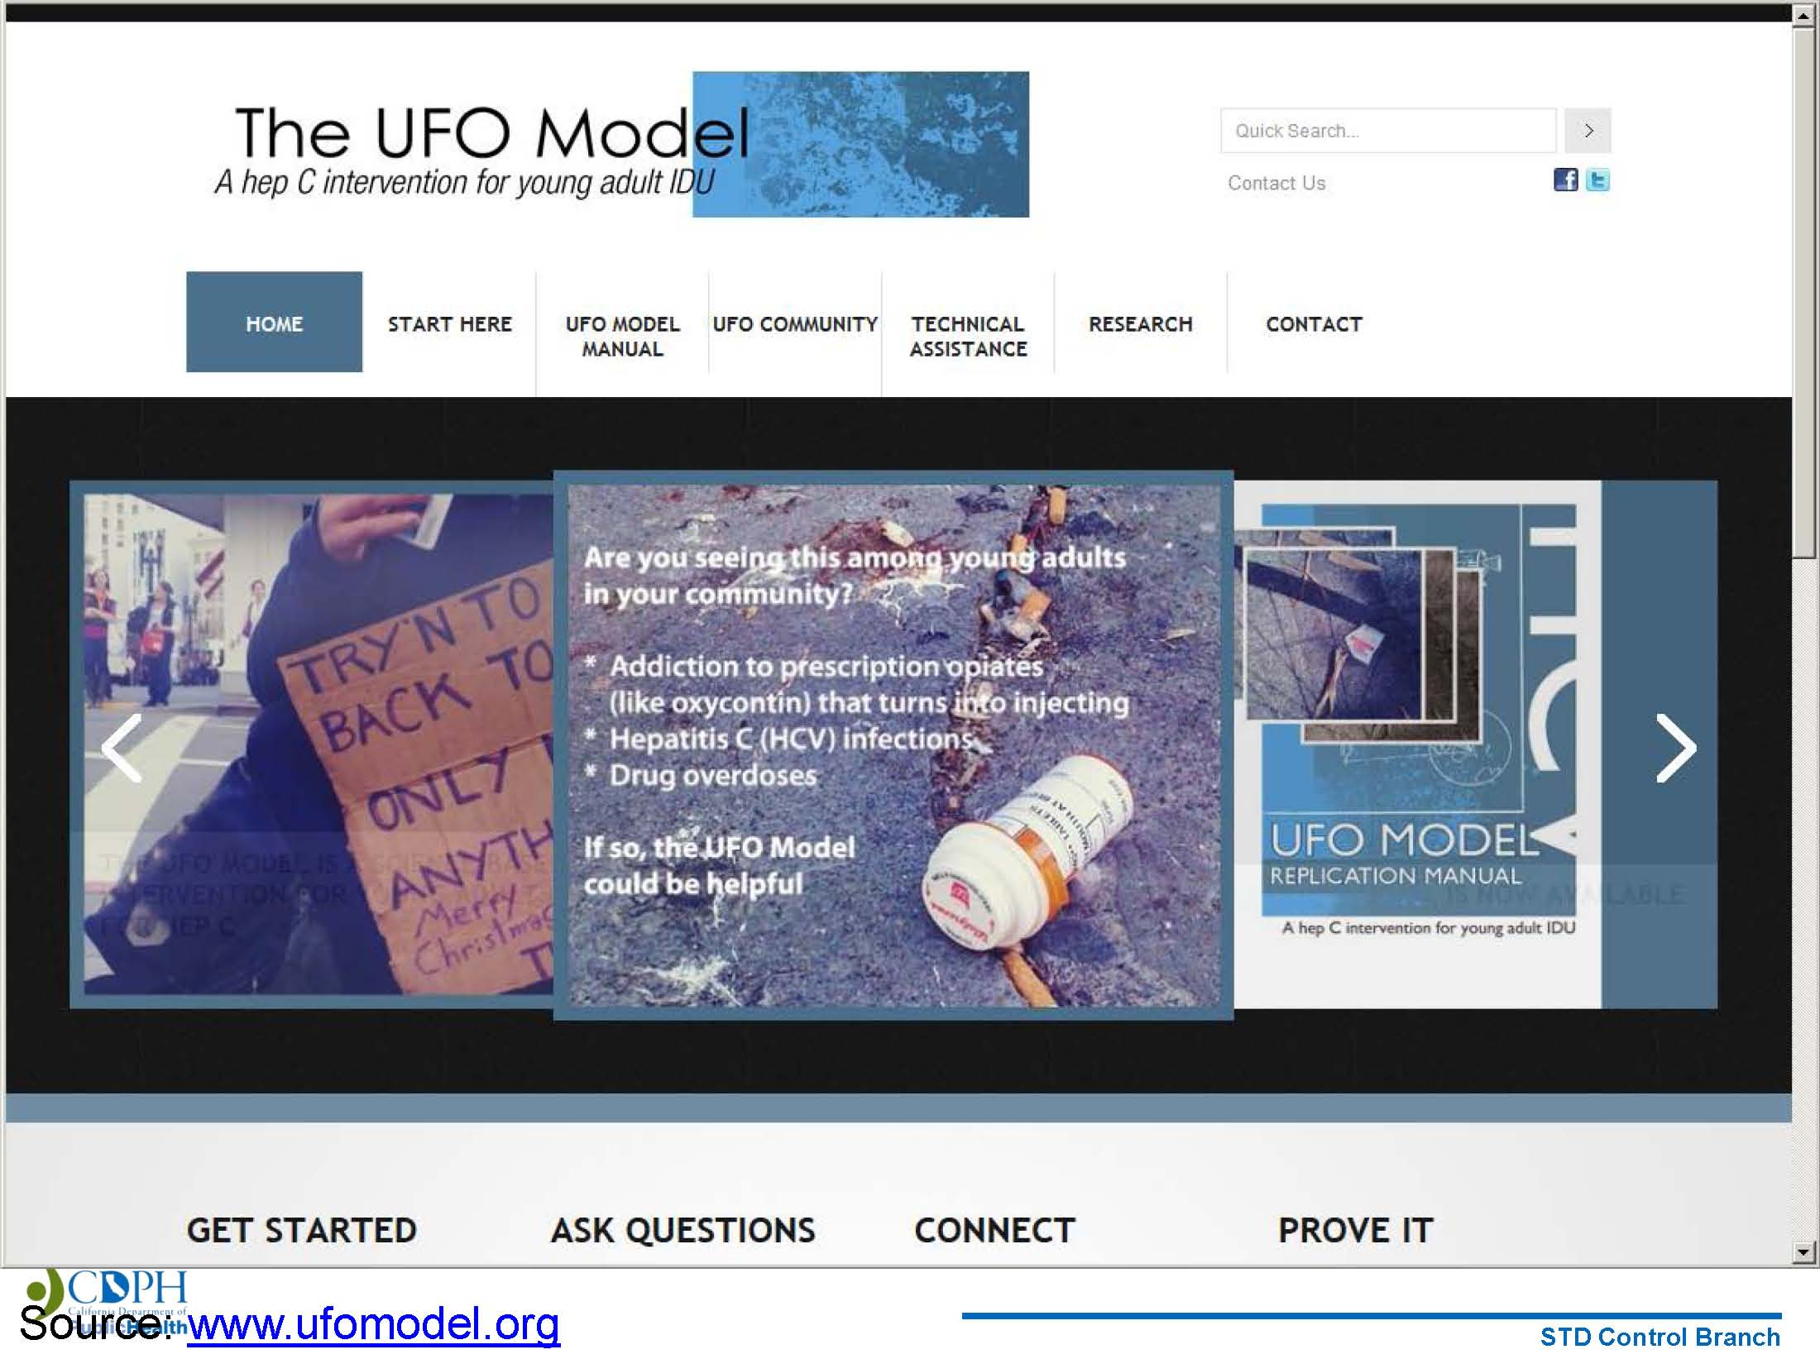
UFO Model (UCSF) for Hepatitis C Prevention among Young IDUs
119
Notes:
The UFO Model was established in 1996 and includes a series of community-based research studies of HIV, Hepatitis B, and Hepatitis C, health consequences of drug use, vaccine feasibility and adherence in young adult injectors in San Francisco. Features of the UFO Model include: cultural competency/non-judgment; youth-centered focus; outreach and consistency; and collaboration and referrals. Core components include: outreach and education; youth-centered referrals; drop-in center; syringe access; HCV testing and HAV/HBV vaccination; and education and support groups. The core HCV prevention message is: (1) Do not share needles or injecting equipment (e.g., cookers, cottons, water, tourniquets); always use your own stuff and use it ONCE; and use “a new kit for every hit.” Additional prevention messages include: (1) get tested for Hepatitis C; (2) know the status of your injecting partners; (3) teach your injection partners how to be safe; (4) if someone else injects you, make sure they inject you first and themselves second; (5) avoid sharing tattoo equipment, razors, and nail clippers; and (6) get vaccinated against Hepatitis A and Hepatitis B.
REFERENCE
University of California San Francisco, Center for AIDS Prevention Studies. Additional information available at:
http://caps.ucsf.edu/ufo-study/.

Slide 120

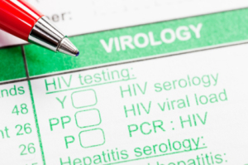
Take Home Points for Clinicians
Know - your local resources (substance use disorders treatment facilities, 12-step meetings, mental health resources, etc.).
Engage – screen youth for risky
substance use and practice ways
to communicate effectively with
young patients.
Remember - substance use is treatable
and every clinic visit is an opportunity for intervention and prevention messages.
Encourage – Young patients and staff to discuss the challenges of substance use and remind them of the importance of continued HIV care, if applicable.
120
Notes:
It is important to be familiar with local resources, including substance use disorders treatment facilities, 12-step meetings, and mental health resources. Alcohol abuse impacts the user’s brain and body, but can be treated. Continue to dialogue with patients about their alcohol use and the importance of continued HIV care.
Additional Information for the Trainer(s)
Alcohol-dependent patients should be referred to treatment programs. HIV clinicians should be familiar with local resources for substance-abuse treatment and related psychiatric care, including inpatient or residential treatment, outpatient treatment, and support groups such as Alcoholics Anonymous. In addition, clinicians should assess for potential withdrawal symptoms. Clinicians should also consider the use of pharmacotherapy in dependent individuals. Medications are available that target neurotransmitters involved in the reinforcing effects of alcohol use. Pharmacotherapy for alcohol dependence in combination with behavioral counseling can reduce relapse and help maintain abstinence. HIV clinics offer a number of advantages as a site for alcohol pharmacotherapy. These clinics are involved in long-term patient care, are generally characterized by integration of a variety of specialty services (e.g., psychiatric and OB/GYN services), and have access to funding for prescription medications. Further, many HIV clinics use intensive case management models that promote outreach to and retention of patients who are often challenging to treat. However, currently there are no data on pharmacotherapy for alcohol dependence in patients with HIV infection, although a number of trials are under way. Further, pharmacotherapy for dependence has shown
only modest efficacy in clinical trials.
Other things clinicians can do include: (1) offer patients an HIV test as a regular part of medical care; (2) offer patients STD testing and treatment services; (3) engage patients in HIV treatment and make sure the amount of virus is as low as possible; (4) engage and encourage people with HIV continue getting HIV medical care; (5) provide HIV prevention counseling to patients on how to protect their health and avoid passing the virus on to others; and (6) refer to other prevention services (for example, partner counseling) as needed.

Slide 121
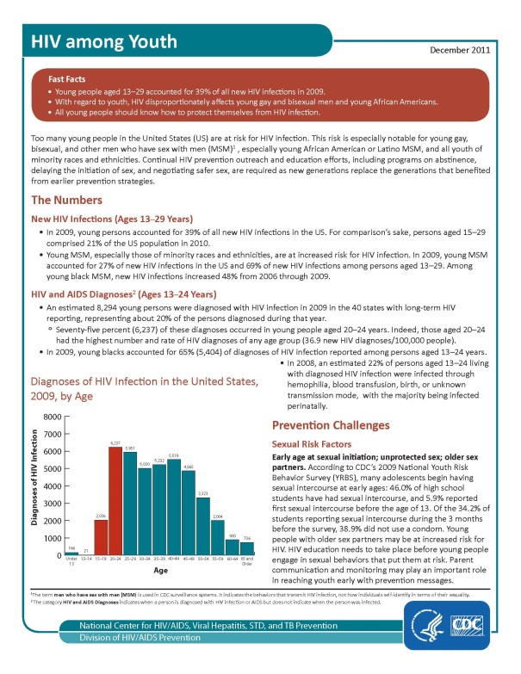
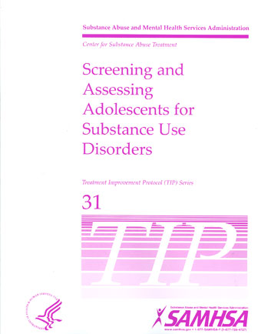
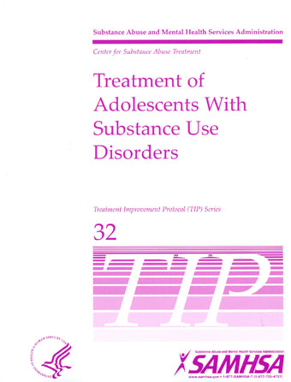
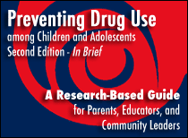
Key Resources
121
Notes:
This slide features a few important resource documents that have been produced that focus on substance use and/or HIV among adolescents and young adults. The featured resources are available free of charge from federal sources.
(The images are hyperlinked when in slideshow view).
Additional Information for the Trainer(s)
TIP 31: Screening and Assessing Adolescents for Substance Use Disorders is available at:
http://store.samhsa.gov/product/TIP-31-Screening-and-Assessing-Adolescents-for-Substance-Use-Disorders/SMA12-4079
Preventing Drug Use among Children and Adolescents (2nd Edition – In Brief) is available at: http://www.drugabuse.gov/publications/preventing-drug-use-among-children-adolescents
TIP 32: Treatment of Adolescents with Substance Use Disorders is available at:
http://store.samhsa.gov/product/TIP-32-Treatment-of-Adolescents-With-Substance-Use-Disorders/SMA12-4080
HIV among Youth is available at: http://www.cdc.gov/hiv/pdf/library_factsheet_HIV_amongYouth.pdf
An important website to bookmark is UCSF’s HIV InSite: http://hivinsite.ucsf.edu/InSite.

Slide 122
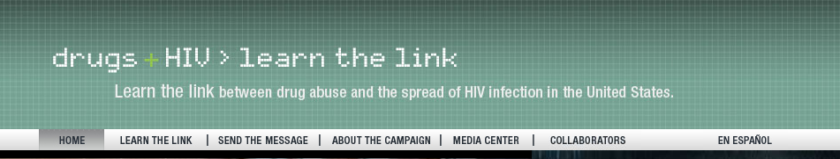
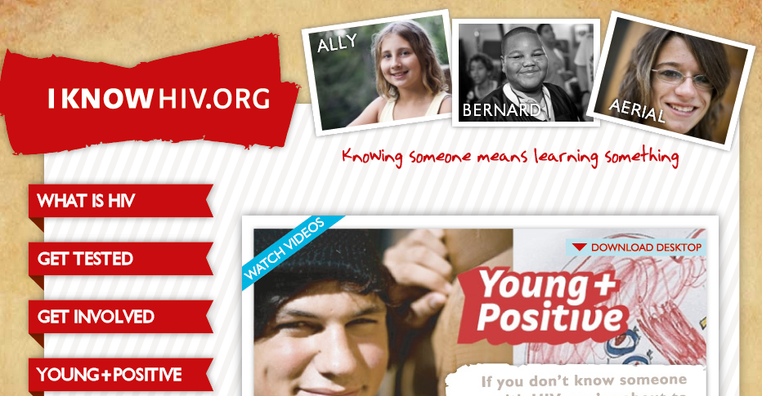
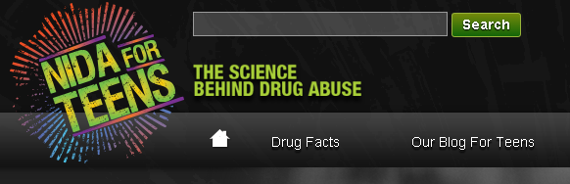
hiv.drugabuse.gov
HIV/Substance Use Websites Targeted to Youth
http://www.iknowhiv.org/
http://teens.drugabuse.gov/drug-facts/hiv-aids-and-drug-abuse
122
Notes:
This slide features a few websites that are geared specifically towards youth, and discuss HIV and drug abuse.
(The images are hyperlinked when in slideshow view).

Slide 123
Substance Use Disorders in Minority MSM
This 6-hour, self-paced course is designed for behavioral healthcare professionals working with minority men experiencing substance use disorders.
Developed by the Pacific Southwest, Central East, Northeast and Prairielands ATTC Regional Centers with special project supplemental funding from SAMHSA.
Enrollment information available at: http://www.healtheknowledge.org
123
Notes:
The Substance Abuse and Mental Health Services Administration’s (SAMHSA) Center for Substance Abuse Treatment (CSAT) received funding through the Minority AIDS Initiative in 2008 to develop an online curriculum on the substance use disorders treatment and HIV/AIDS prevention/ intervention needs of minority men who have sex with men (MSM). The purpose of the curriculum is to provide awareness and knowledge that will enable addiction treatment providers to more effectively meet the needs of culturally specific subpopulations of HIV-positive, substance abusing MSM or those at risk for HIV/AIDS. CSAT has invited four regional ATTCs, including the PSATTC, to apply for a special project supplemental award to each develop one of the four online, self-paced training manuals.

Slide 124
Resources & Local Referrals
Los Angeles County STD Clinic and Schedules
Find out where to get free, confidential STD testing/treatment.
inSPOT.org
Includes an interactive STD clinic finder map for the U.S., Canada, Puerto Rico, American Samoa, Commonwealth of the Northern Mariana Islands, Guam, and Peru.
SPECTRUM
A Charles R. Drew University-affiliated mental health center in the Watts/Willowbrook areas of South Los Angeles; provides comprehensive mental health services to individuals living with HIV/AIDS and their significant others/family members, including youth and young adults. For more information call
(323) 563-4939.
124
Notes:
This slide features resources and local referrals.

Slide 125
Resources & Local Referrals
AIDS Healthcare Foundation (AHF) Men's Wellness Center
The AHF Men's Wellness Center is dedicated to providing sexual health services to men in LA County, including gay and bisexual men and male to female transgender clients.
LA Gay and Lesbian (GLC) Center Sexual Health Program
The L.A. Gay & Lesbian Center Sexual Health Program offers free sexually transmitted disease screening, treatment and education specifically for the gay, lesbian, bisexual and transgender community (though everyone is welcome).
125
Notes:
This slide features resources and local referrals.

Slide 126
Resources & Local Referrals
HIVcare.org – Provides addresses of free HIV testing sites
FreeHIVtest.net – Provides free HIV tests at AHF centers and Out of the Closet stores
plannedparenthood.org/los-angeles – Search for testing sites by zip code; info about STDs/HIV
California HIV/AIDS Service Referrals – http://cdcnpin.org/ca/
aidshotline.org (check website)
800-367-AIDS: 9 AM to 9 PM weekdays and 10 AM to 6 PM on weekends
126
Notes:
This slide features resources and local referrals.

Slide 127
What did you learn?
Notes:
INSTRUCTIONS
The purpose of the following five questions is to test the post-training knowledge as it relates to the topic of Youth, Substance Abuse, and HIV. The five questions are formatted as either multiple choice or true/false questions. Read each question and the possible responses aloud, and give training participants time to jot down their response before moving on to the next question. Reveal the correct answer to each question.

Slide 128
#1: Experimentation with drugs and/or alcohol is normal during adolescence.
True
False
128
Notes:
ANSWER KEY
#1 – correct response is B (False)

Slide 129
#2: Adolescents substance use may be more likely to result in all of the following except:
  Memory problems
  Learning problems
  Intoxication (motor impairment and sedation)
  Substance Dependence
129
Notes:
ANSWER KEY
#2 – correct response is C (Intoxication [motor impairment and sedation])

Slide 130
#3: Who has the higher rates of current alcohol use among youth aged 12-17?
Females
Males
Rates are equal
130
Notes:
ANSWER KEY
#3 – correct response is A (Females)

Slide 131
#4: Among females who are at risk for or are HIV+, all of the following variables predict substance abuse except being:
  Younger
  HIV positive
  Homeless
  Involved in the criminal justice system
  Positive for an STD
  Involved in survival sex
  Engaged in risky sex
131
Notes:
ANSWER KEY
#4 – correct response is E (Positive for an STD)

Slide 132
#5: Because of the relatively short duration of use, data suggests that the best intervention strategy for opioid using youth is immediate medical withdrawal followed by supportive counseling.
True
False
132
Notes:
ANSWER KEY
#5 – correct response is B (False)

Slide 133


Thank you for your time!
For more information:
Tom Freese: tfreese@mednet.ucla.edu
Beth Rutkowski: brutkowski@mednet.ucla.edu
Maya Gil-Cantu: maya@HIVtrainingCDU.org
Pacific Southwest ATTC: www.psattc.org
PAETC Training calendar: www.HIVtrainingCDU.org
Notes:
FINAL SLIDE
This concludes the presentation. Thank the participants for their time and address any last-minute questions about the content. Encourage participants to reach out to the Pacific Southwest ATTC or Pacific AETC, should they have questions or concerns following the training session.

